Slide 1
KUNDAN – Eternia 2
(2 & 3 BHK Homes)
Hoardings

Slide 2


Slide 3


Slide 4


Slide 5
KUNDAN – Eternia 2
(2 & 3 BHK Homes)
Hoardings – Rendition 2

Slide 6


Slide 7
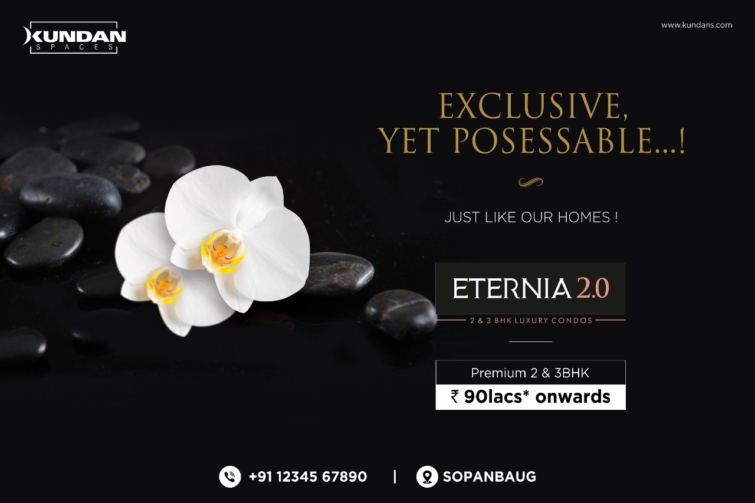

Slide 8
KUNDAN – PRAANGAN
(1, 2 & 3 BHK Homes)
Brochure cover

Slide 9


Slide 10


Slide 11
KURLON MATTRESS

Slide 12
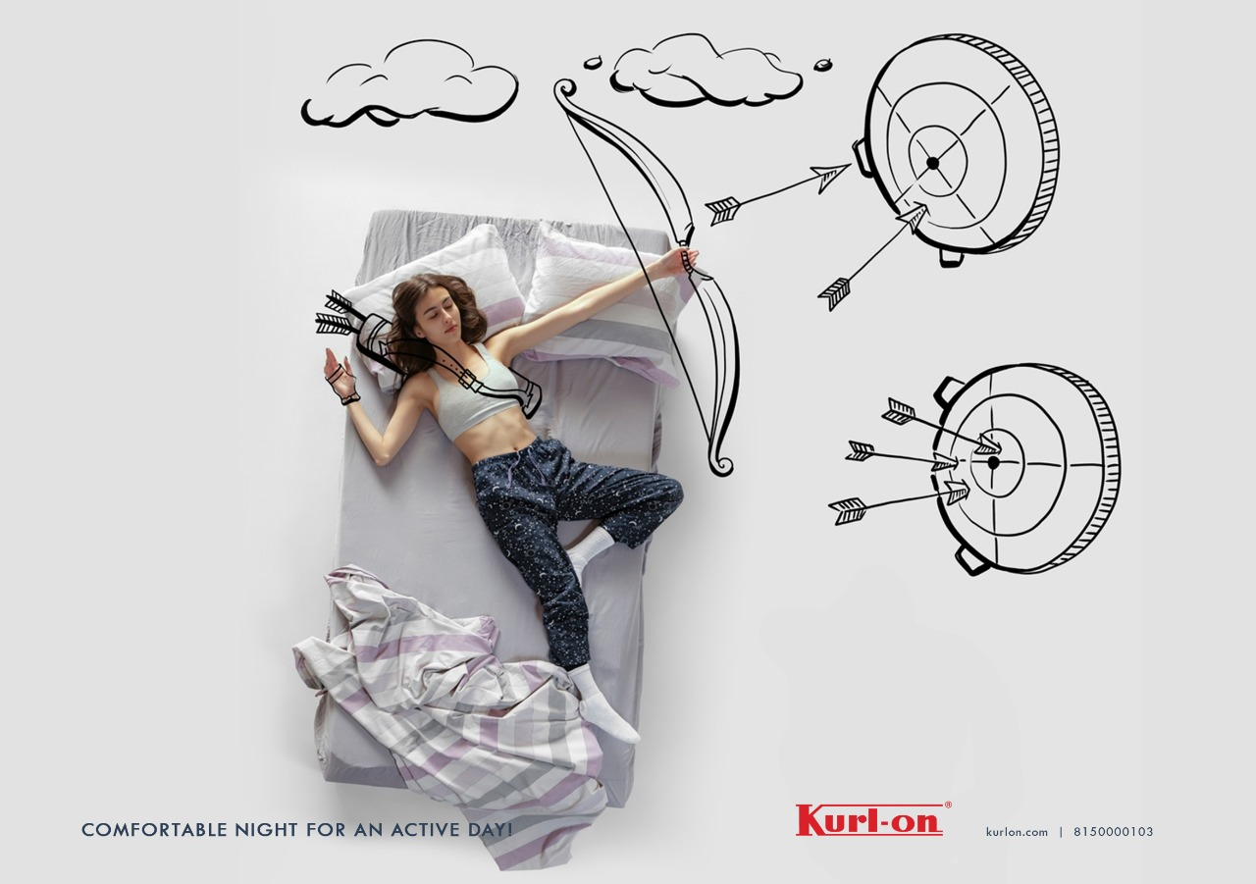

Slide 13
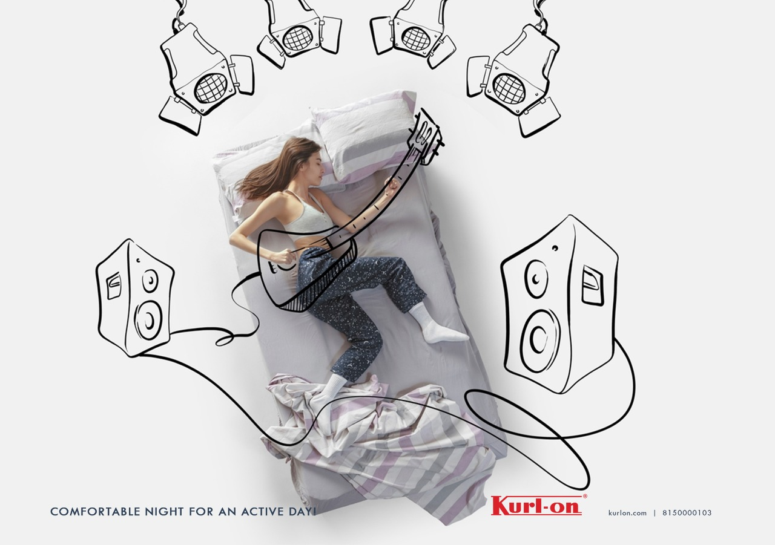

Slide 14
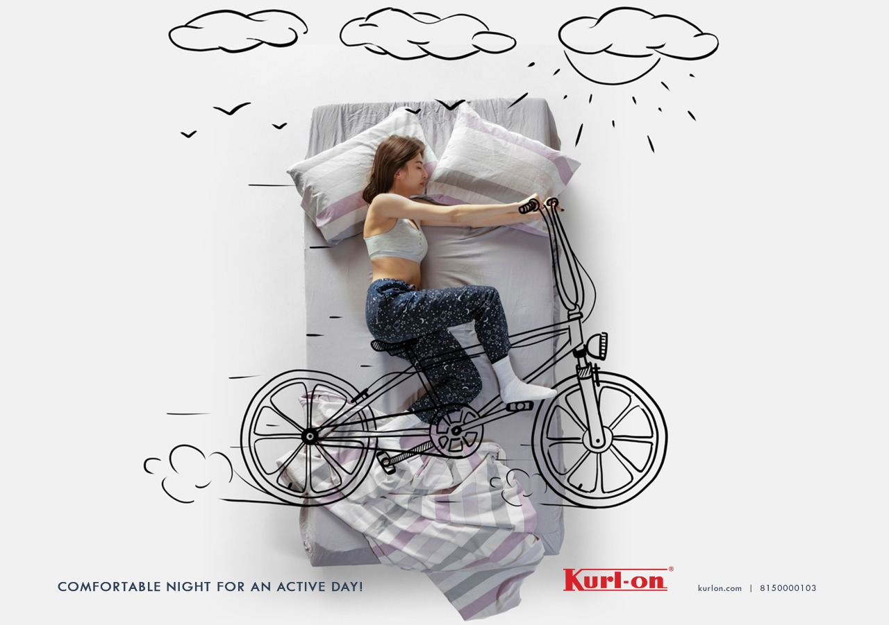

Slide 15
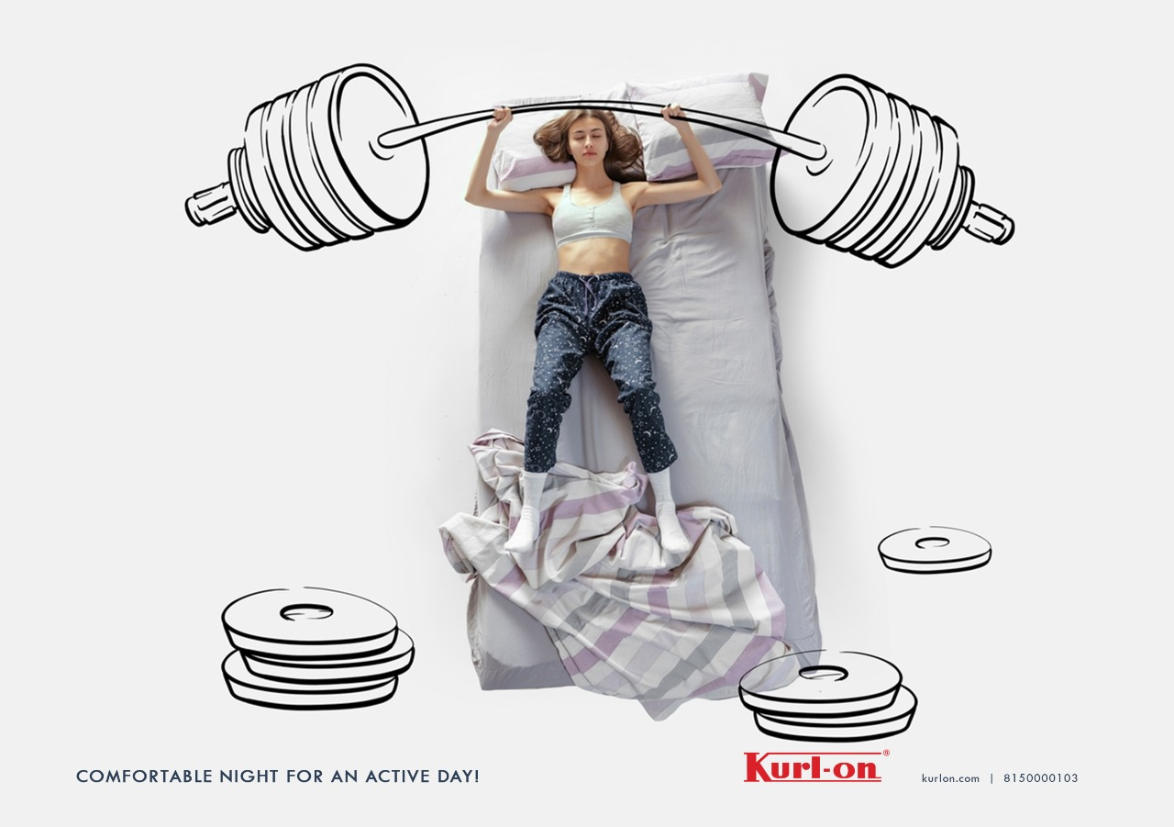

Slide 16
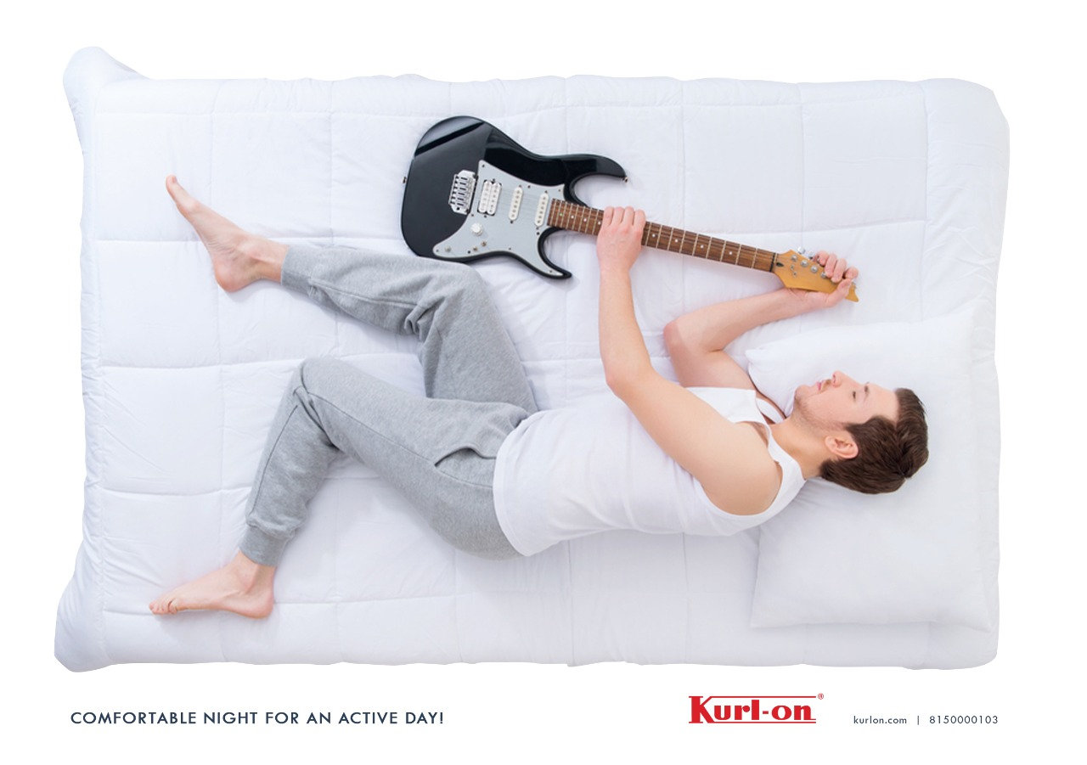

Slide 17
MERUSRI ONE VILLAS
Hoardings

Slide 18


Slide 19


Slide 20


Slide 21
KHUSHI AXIS WORLD
1 and 2BHK Homes

Slide 22
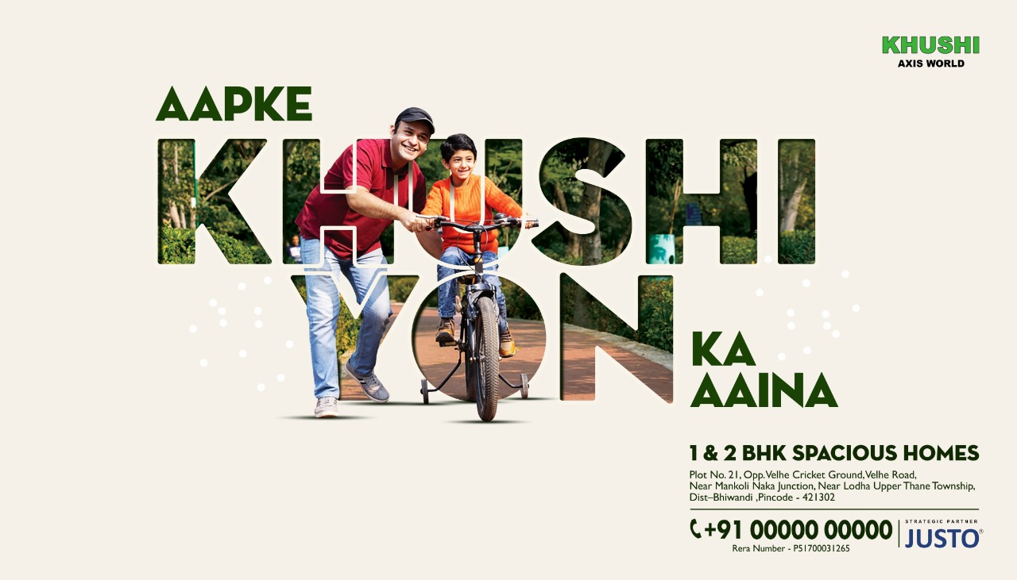

Slide 23


Slide 24


Slide 25
B:LIVE
Electric Bike

Slide 26


Slide 27


Slide 28


Slide 29
KHUSHI AXIS WORLD
1 & 2 BHK homes

Slide 30


Slide 31
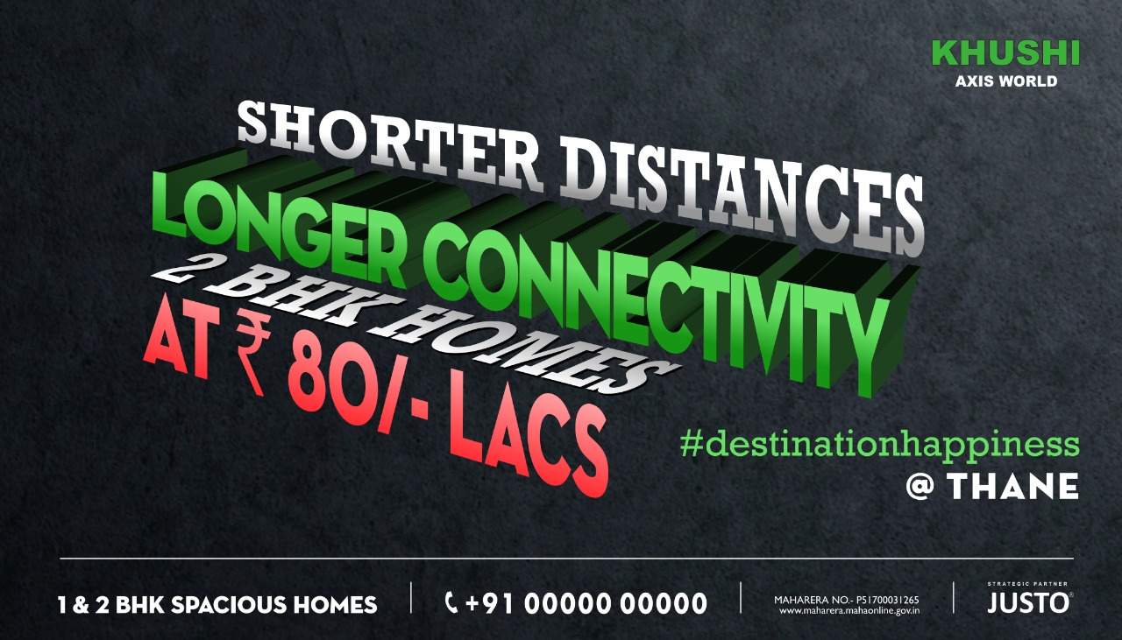

Slide 32


Slide 33
TALENT EDGE
Concept 1

Slide 34


Slide 35


Slide 36


Slide 37
TALENT EDGE
Concept 2

Slide 38


Slide 39


Slide 40


Slide 41
METRO JUNCTION
(Shopping Mall)

Slide 42


Slide 43


Slide 44
Sunlit Grove
3 & 4BHK Villas

Slide 45


Slide 46


Slide 47
STIHL INDIA
(Agricultural equipment)
Independence Day Ad

Slide 48


Slide 49


Slide 50

STIHL
German Engineered equipment for farming,
lawn moving and vacuum cleaning

Slide 51
Merusri Serene
(3 Bed Villas)
Concept 1

Slide 52


Slide 53
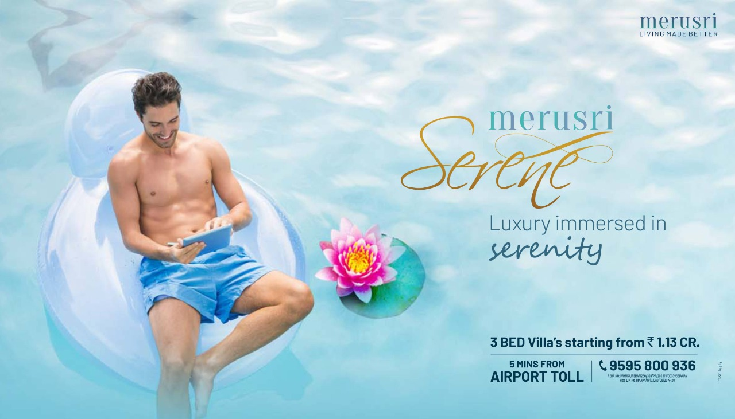

Slide 54


Slide 55
Merusri Serene
(3 Bed Villas)
Concept 2

Slide 56
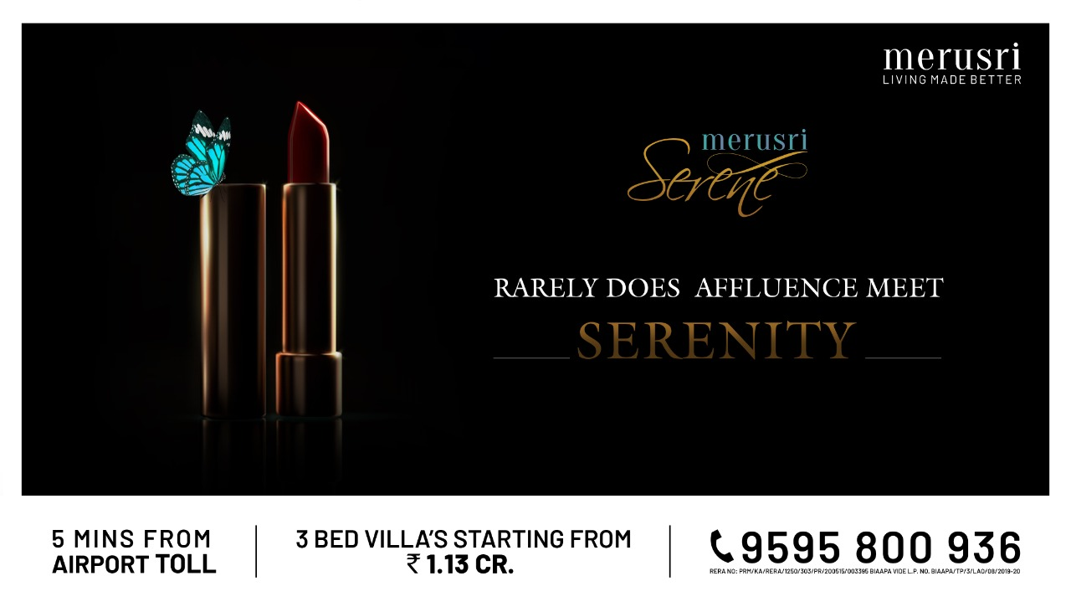

Slide 57
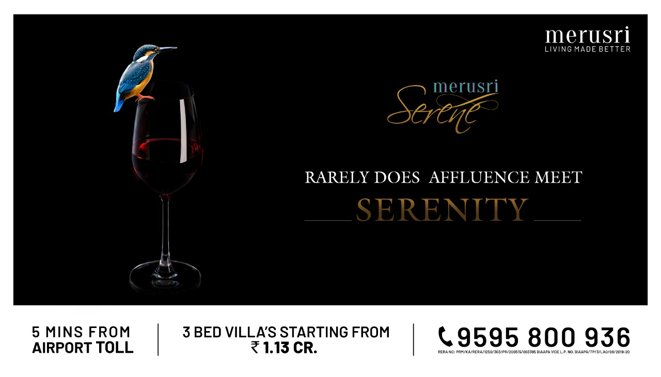

Slide 58
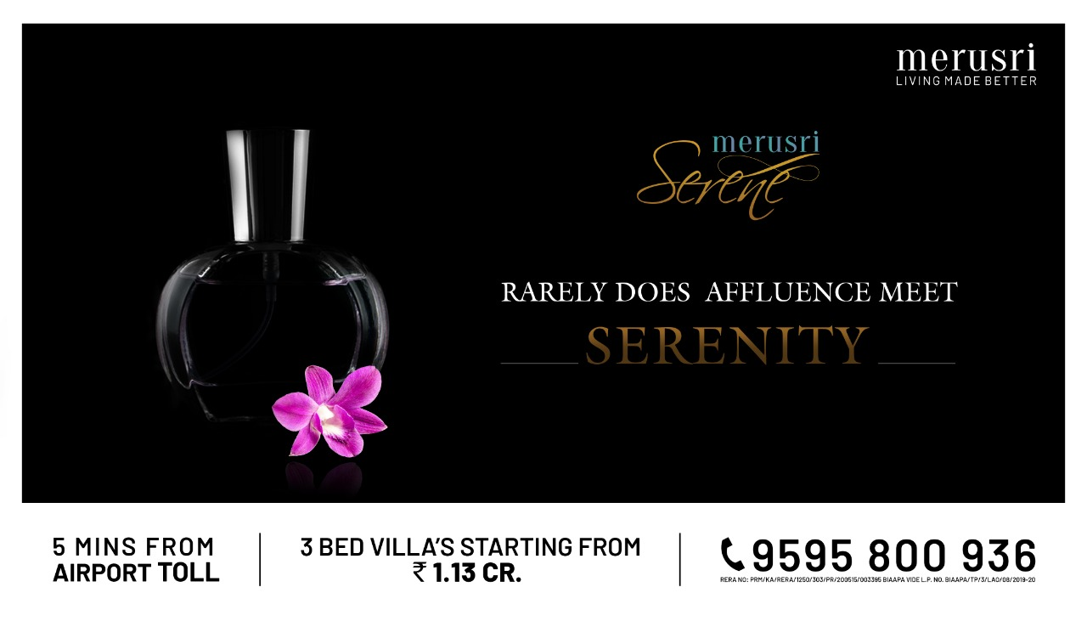

Slide 59
ELASTIC RUN
(B2B Logistics Firm)
CONCEPT 1

Slide 60


Slide 61


Slide 62


Slide 63
ELASTIC RUN
(B2B Logistics Firm)
CONCEPT 2

Slide 64
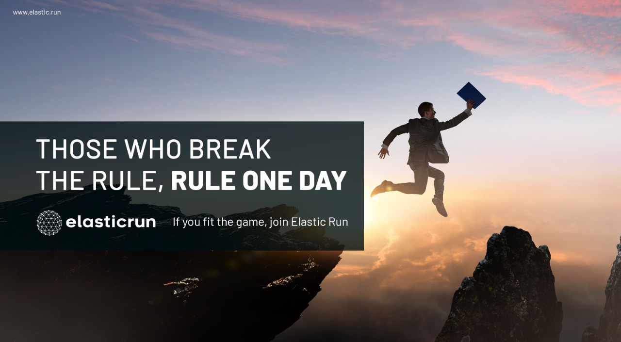
ELASTIC RUN
B2B Logistics Firm
CONCEPT 2

Slide 65
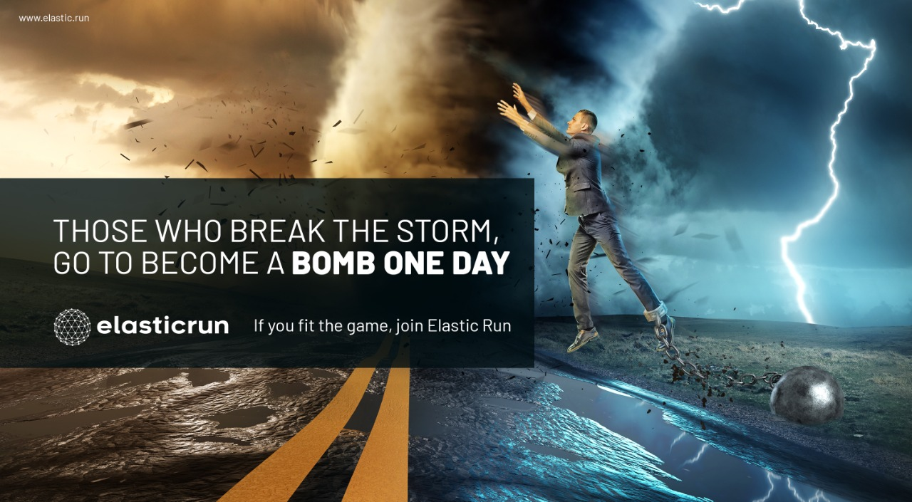

Slide 66
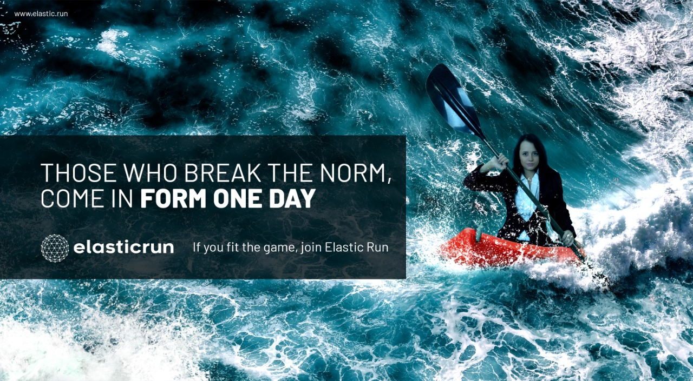

Slide 67
SUNLIT GROVE
(3 & 4 BHK Lavish Villas)

Slide 68


Slide 69


Slide 70


Slide 71
MEGAPOLIS
Integrated Township

Slide 72


Slide 73


Slide 74
PASHMINA WATERFRONT PENTHOUSES
Penthouses on 37th & 38th floor

Slide 75
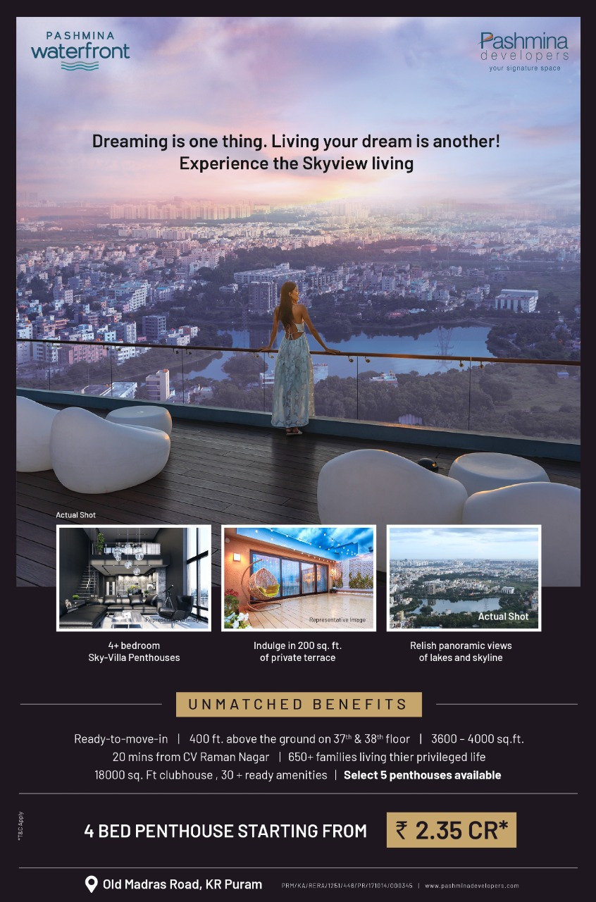

Slide 76


Slide 77
Snow Kingdom
(Snow Theme Park)
Rebranding Campaign

Slide 78
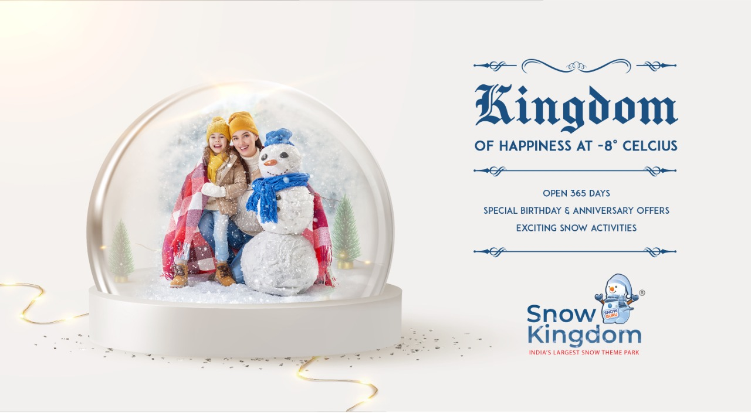

Slide 79
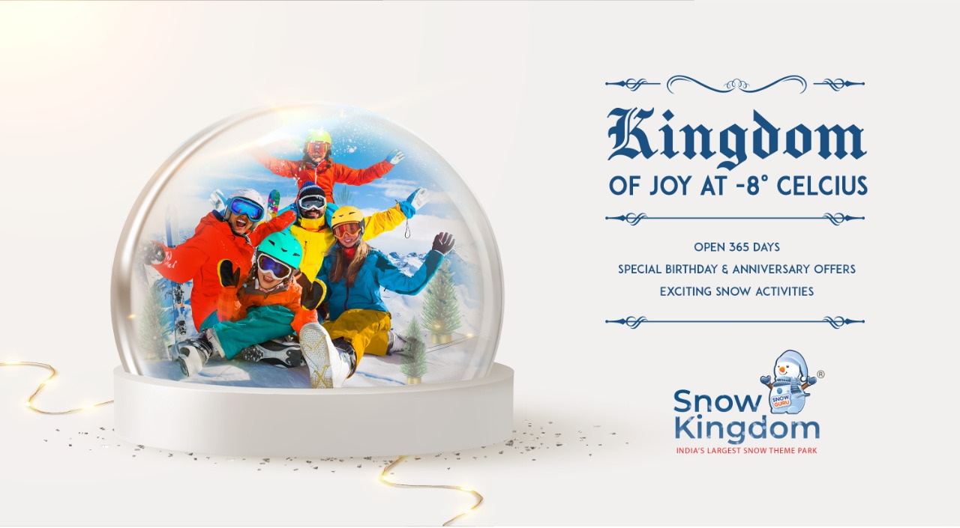

Slide 80
Snow Kingdom
(Snow Theme Park)
Hyderabad Launch Campaign

Slide 81


Slide 82


Slide 83


Slide 84
KUMAR CORP
(Real Estate)
Corporate Campaign

Slide 85


Slide 86


Slide 87


Slide 88
Continental Futura
Child Centric – 1 & 2 BHK Homes

Slide 89


Slide 90


Slide 91


Slide 92
Continental Futura
1 & 2 BHK Homes

Slide 93


Slide 94


Slide 95


Slide 96
YOO ONE
(Ultra Premium Homes)
Concept 1

Slide 97


Slide 98


Slide 99


Slide 100
YOO ONE
(Ultra Premium Homes)
Concept 2

Slide 101


Slide 102


Slide 103


Slide 104
STIHL INDIA
(Genuine Parts Ad)

Slide 105


Slide 106
STIHL INDIA
(Lawn Mower Ad)

Slide 107
JBJ
(Jewellery Brand)

Slide 108


Slide 109


Slide 110
Vaibhavlaxmi Developers
(Real Estate Brand)

Slide 111


Slide 112
WAKAU
Short video sharing social media app

Slide 113
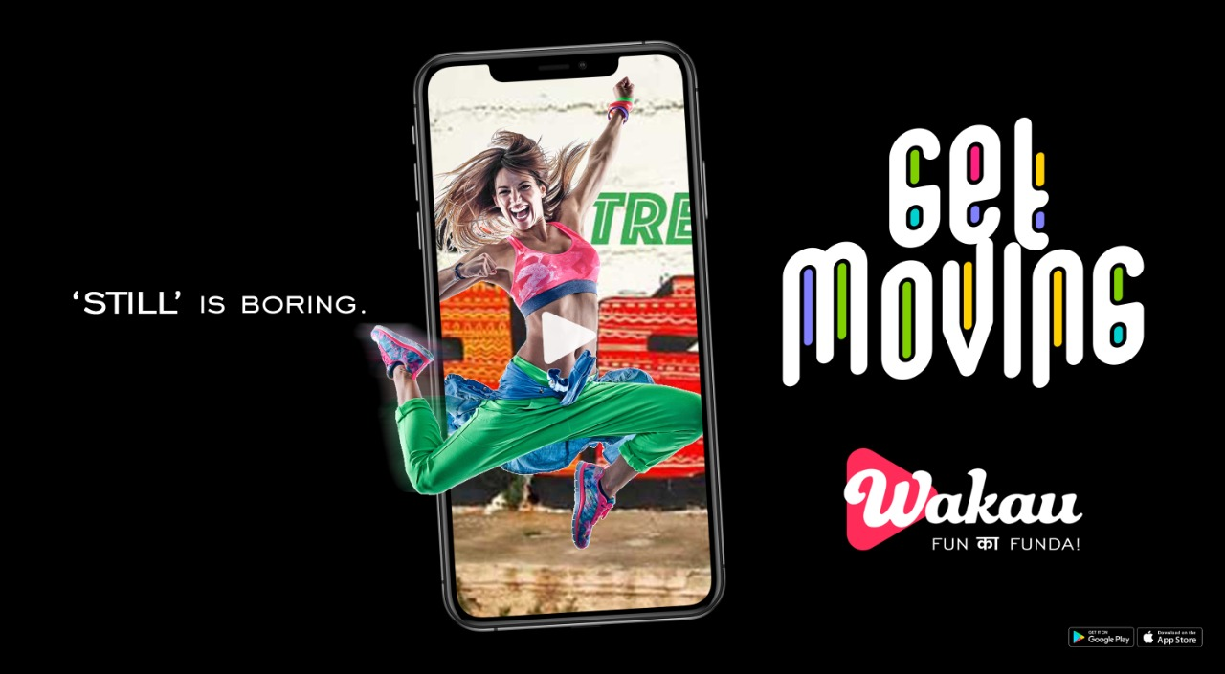

Slide 114
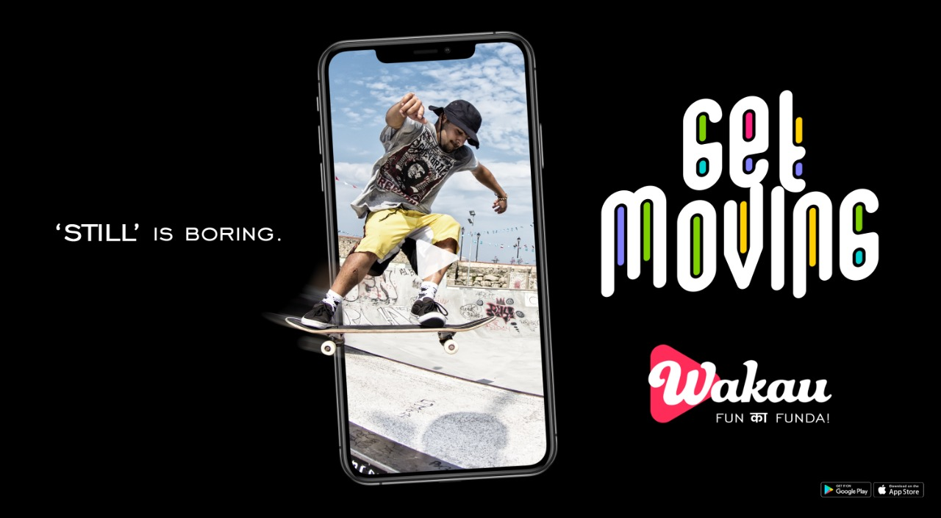

Slide 115
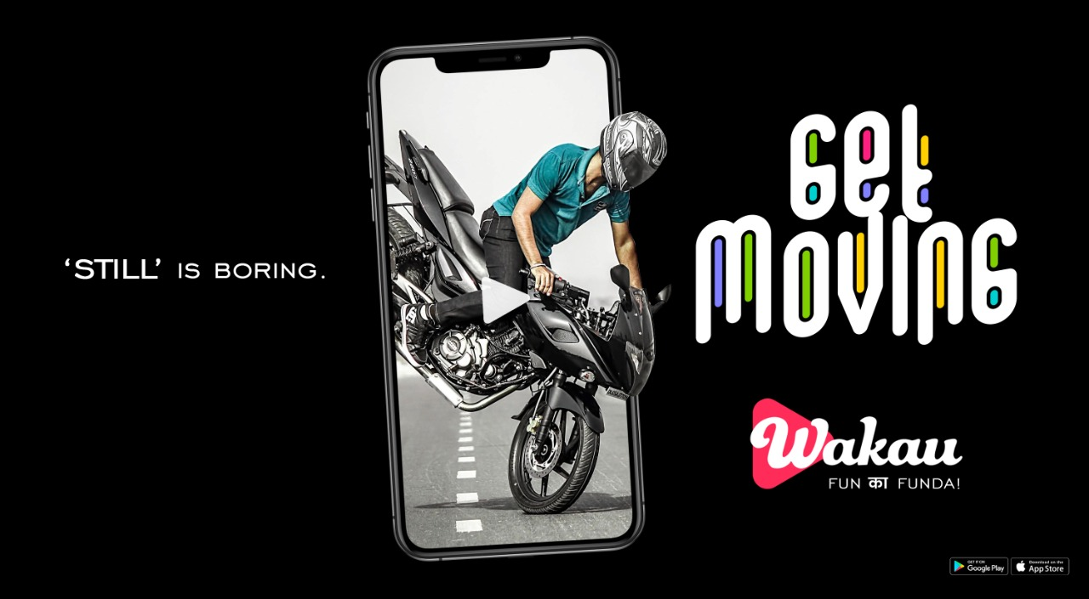

Slide 116
WAKAU
Short video sharing social media app

Slide 117
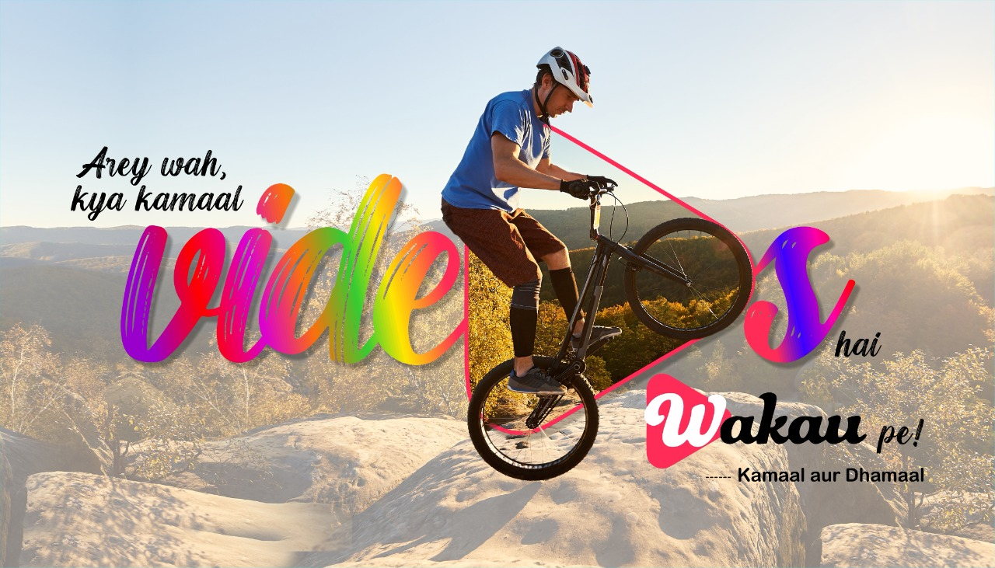

Slide 118


Slide 119
WAKAU
Short video sharing social media app
CONCEPT 3

Slide 120


Slide 121


Slide 122
PASHIMINA WATERFRONT
3 BHK apartments & 4 Bed penthouses

Slide 123
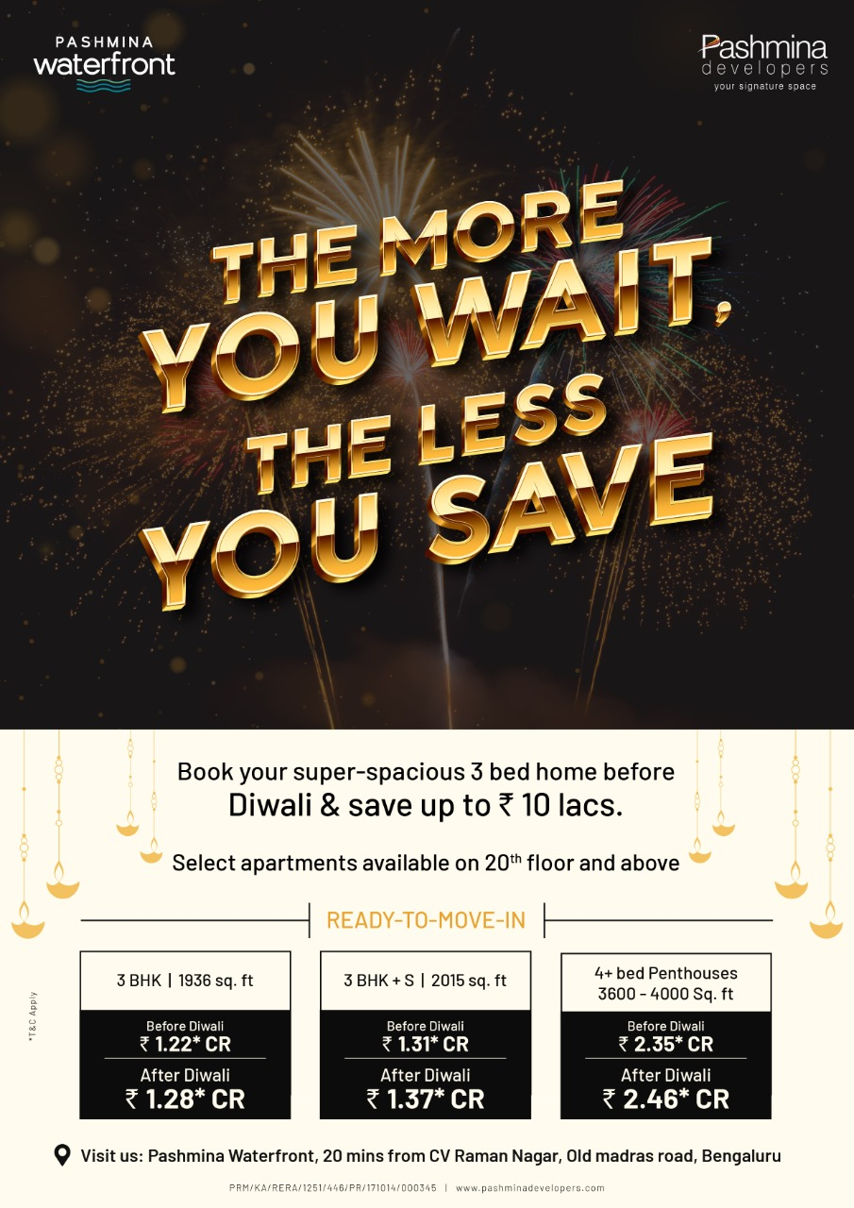

Slide 124
STIHL
Agriculture & cleaning equipment

Slide 125


Slide 126
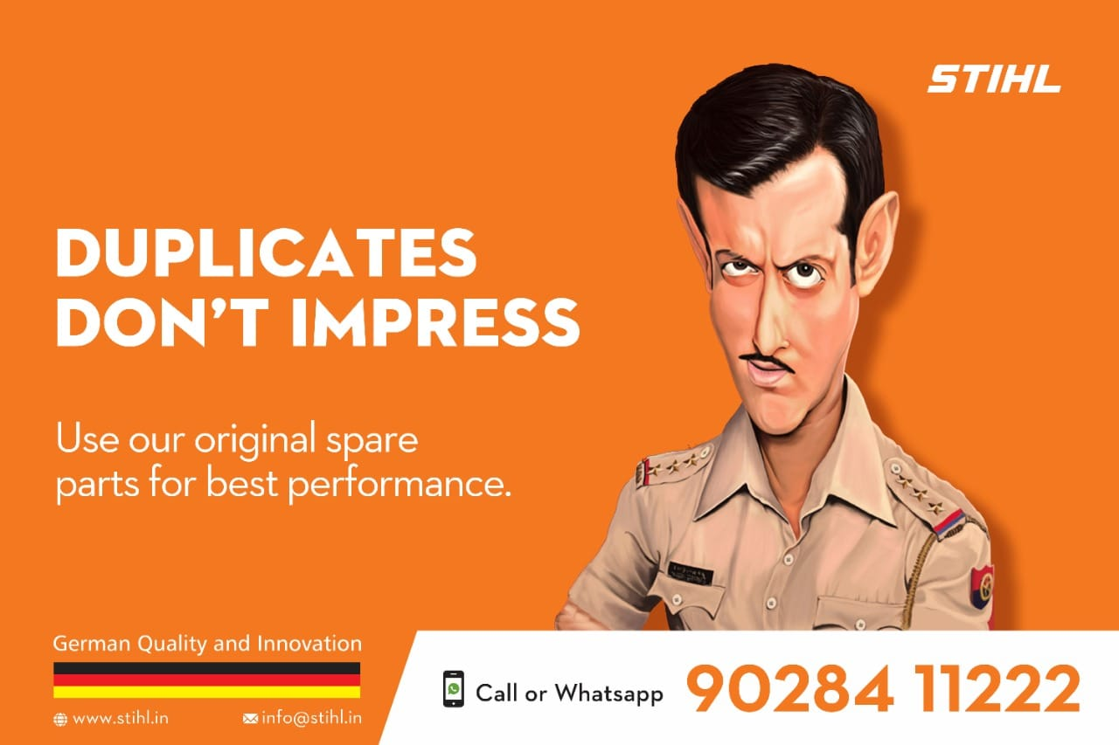

Slide 127


Slide 128
VAIBHAVLAMI JEWELLERS

Slide 129


Slide 130


Slide 131


Slide 132


Slide 133
WAKAU
Social Media Short Video Sharing App
(Campaign 1)

Slide 137
WAKAU
Social Media Short Video Sharing App
(Campaign 1)

Slide 138


Slide 139


Slide 140
Real Estate
Panvelkar Greens
1 and 2 BHK Homes

Slide 141
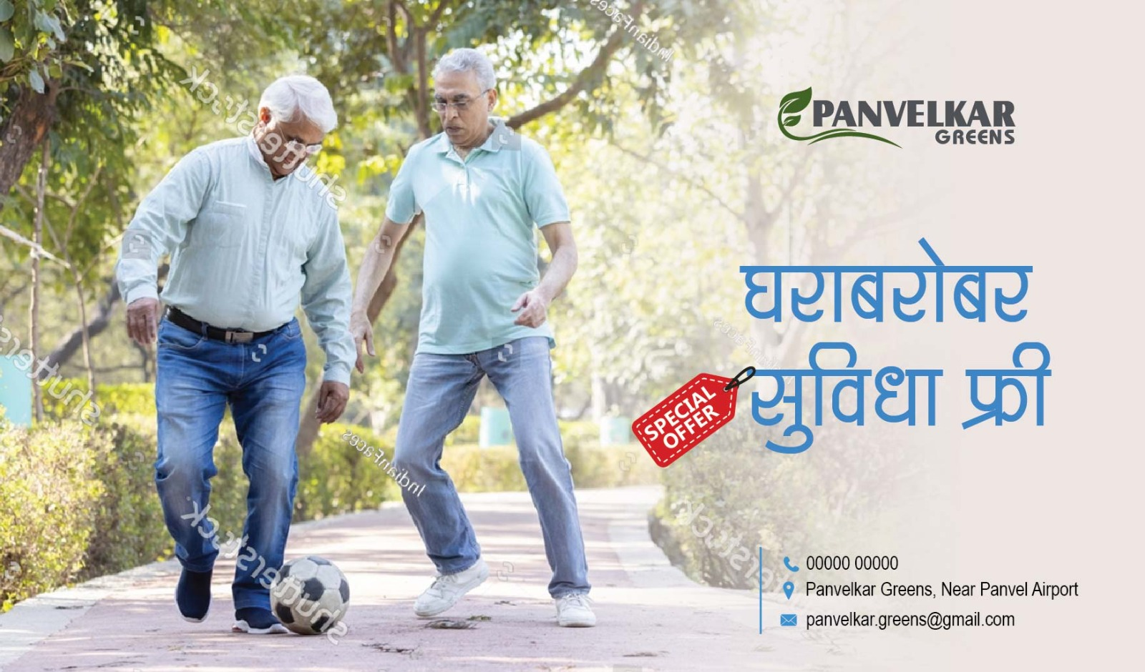

Slide 142


Slide 143
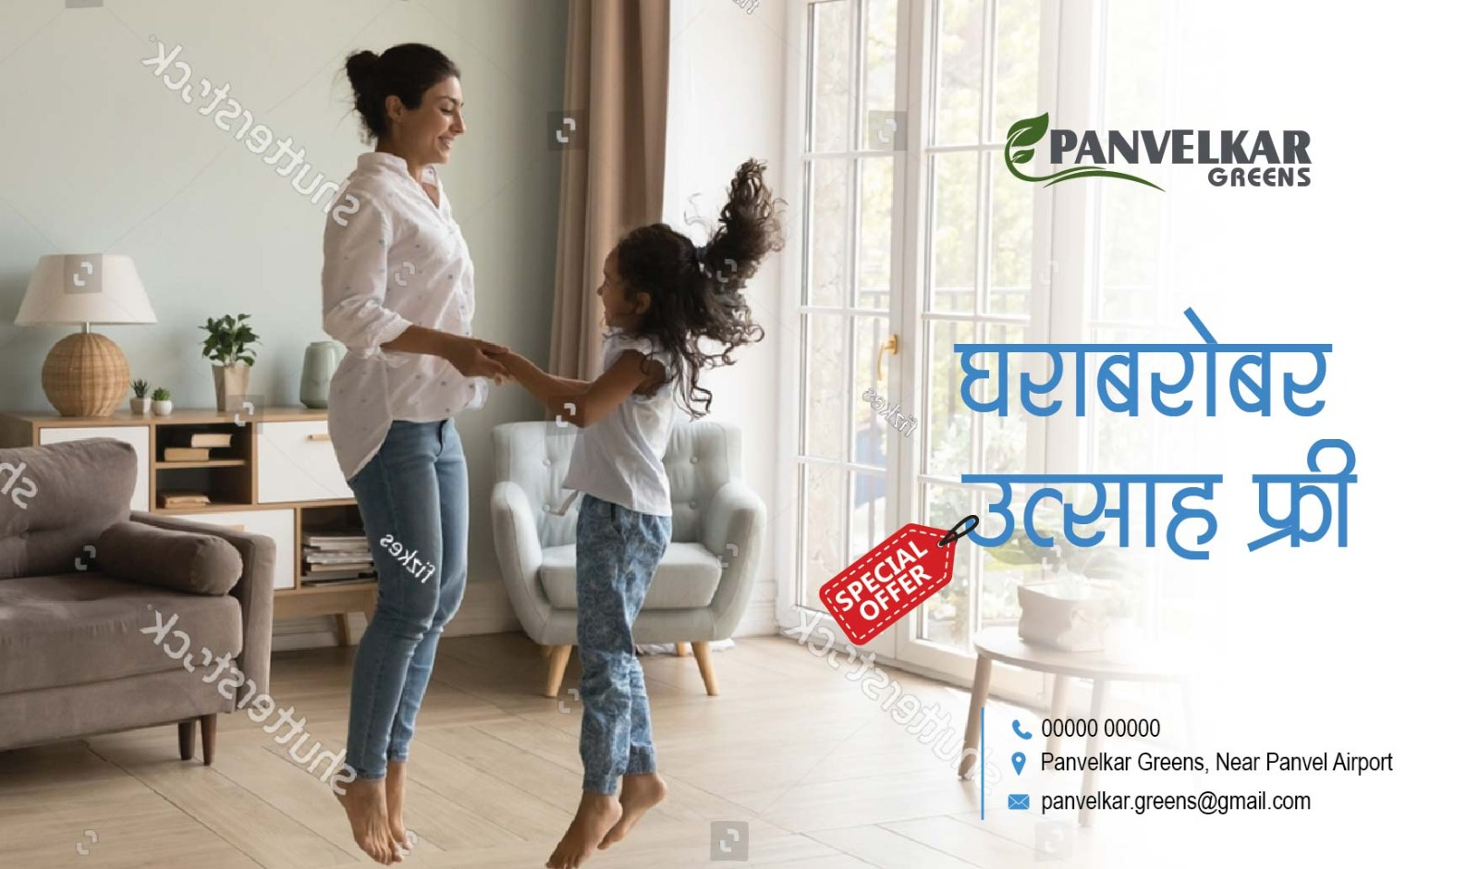

Slide 144
ARATT GROUP
Real Estate
Corporate Campaign

Slide 145
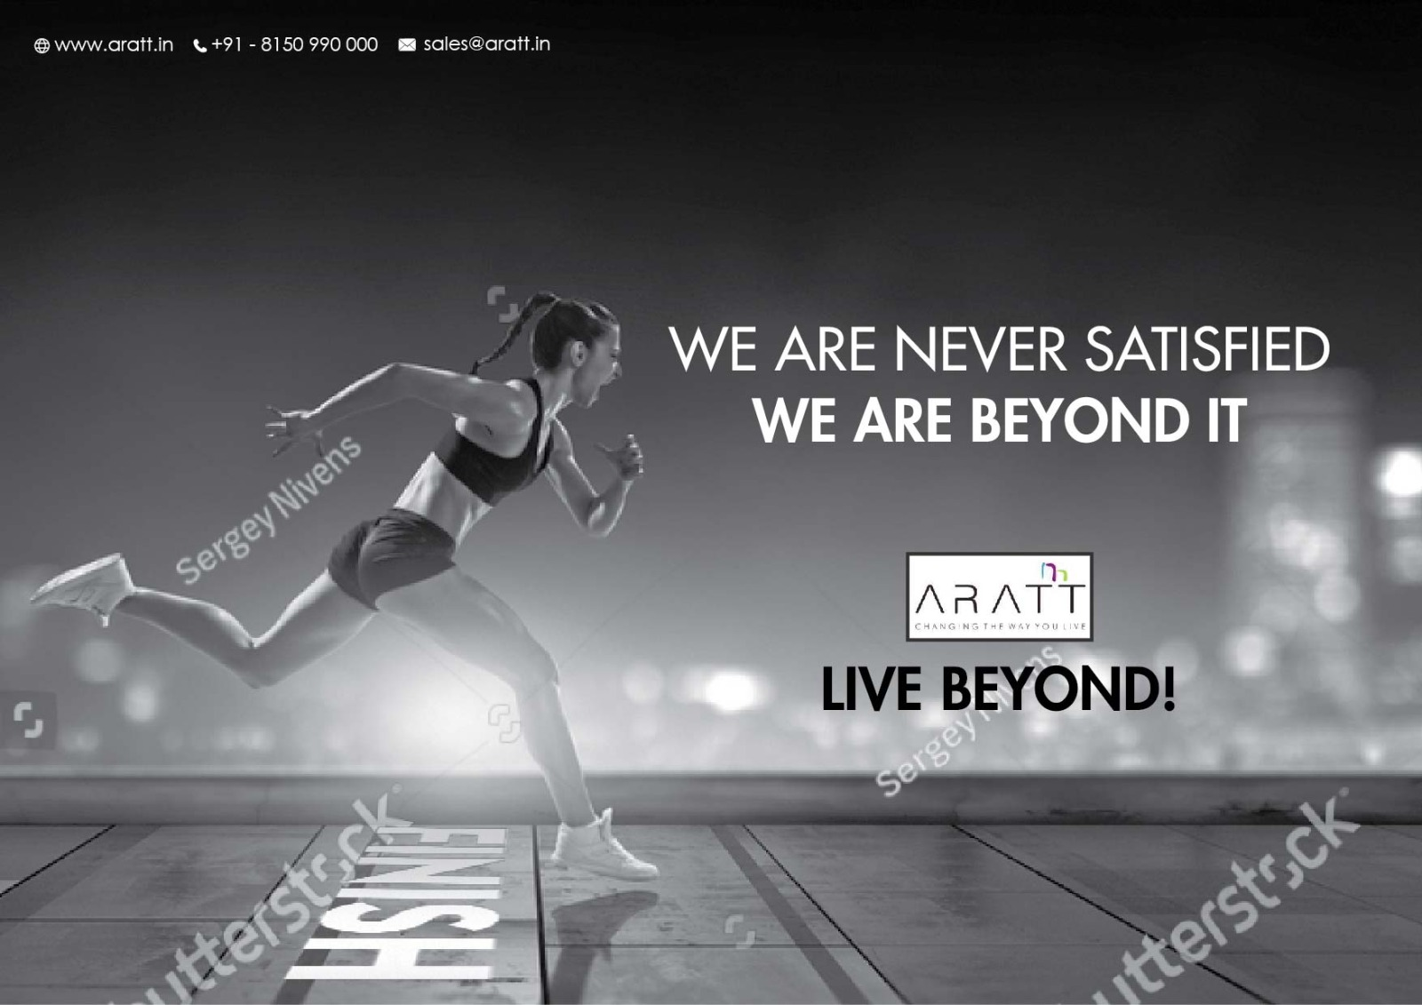

Slide 146
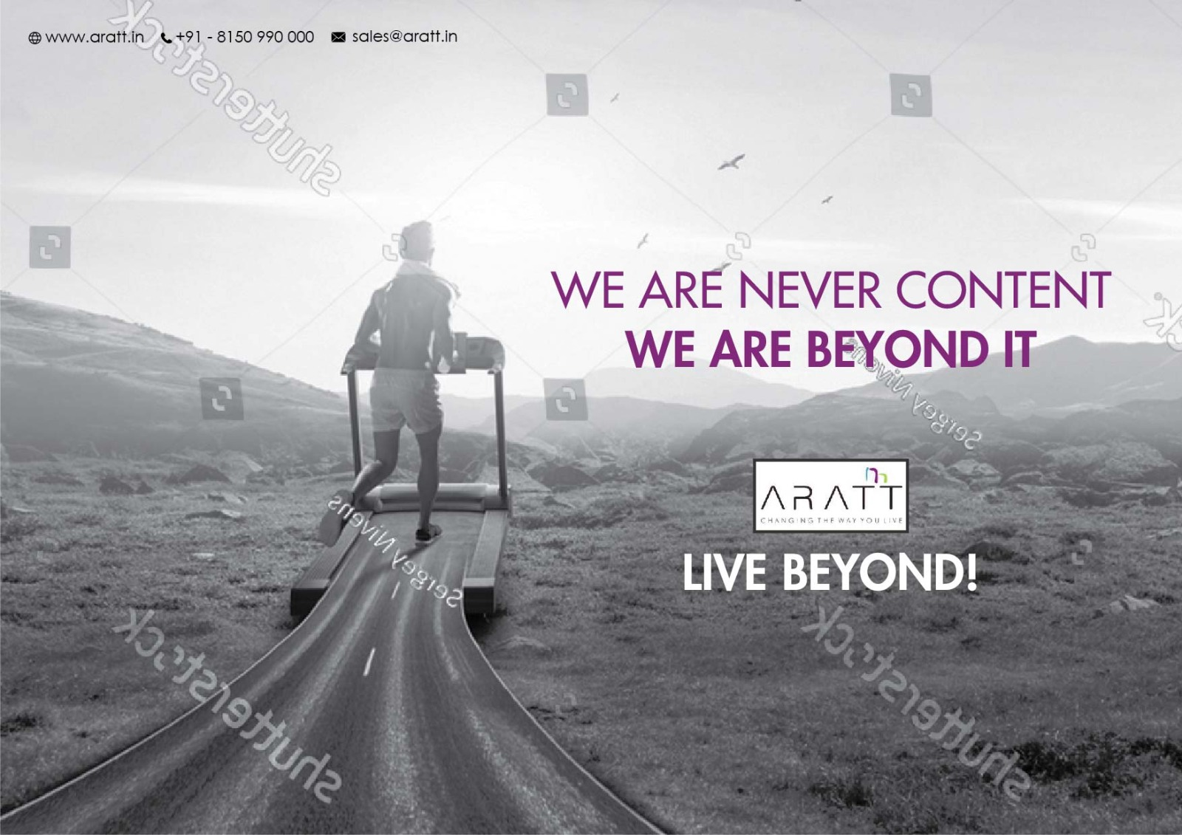

Slide 147
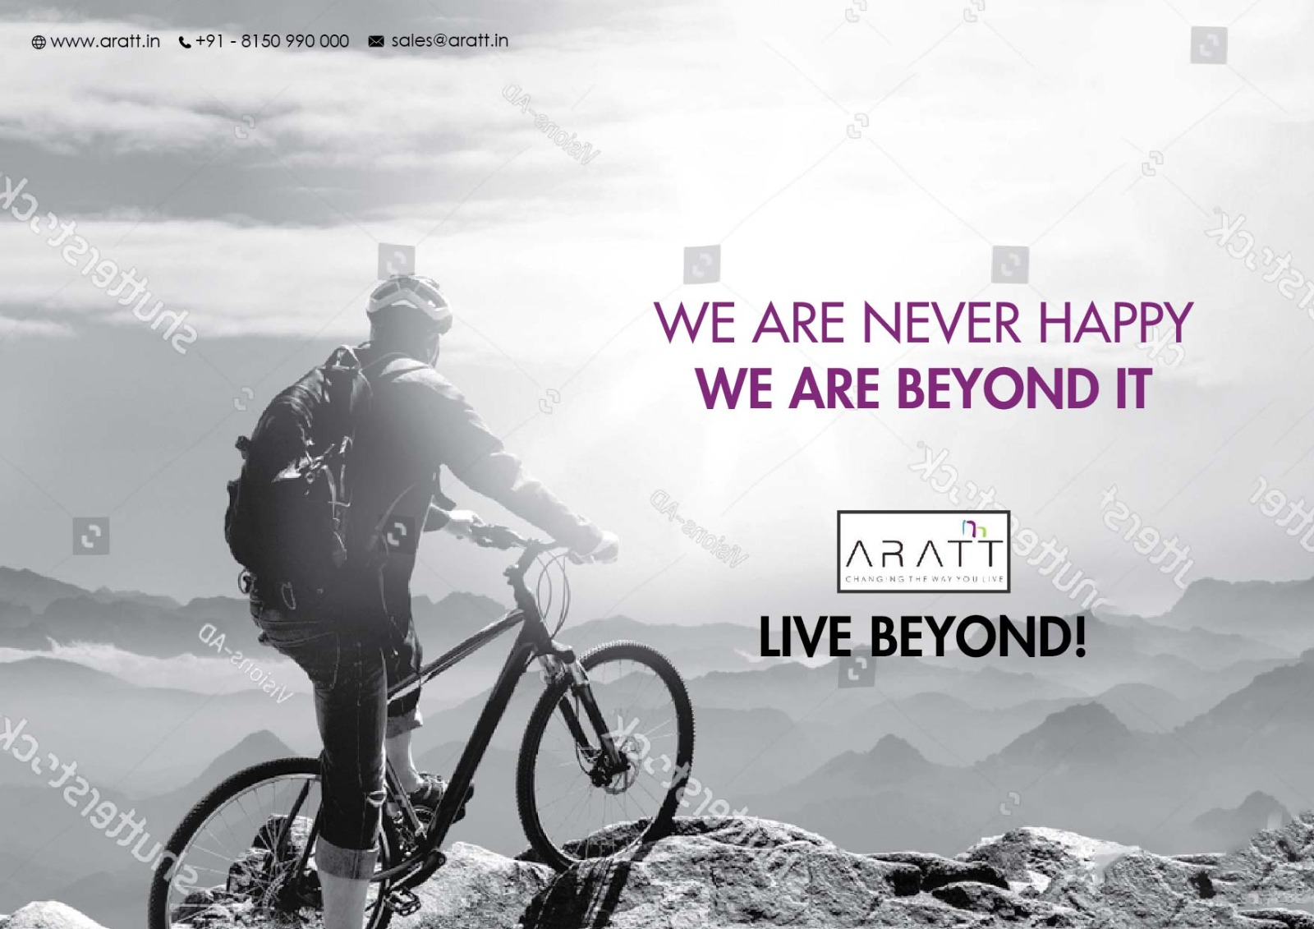

Slide 148
Westend Mall
Jeans and Sneakers Fest

Slide 149


Slide 150


Slide 151
Real Estate
Project – Panvelkar Greens

Slide 152


Slide 153


Slide 154


Slide 155
Real Estate

Slide 156


Slide 157
Father’s Day ads for jewellers

Slide 158


Slide 159


Slide 160


Slide 161
Bhima Internet Service across Maharashtra

Slide 162


Slide 163


Slide 164
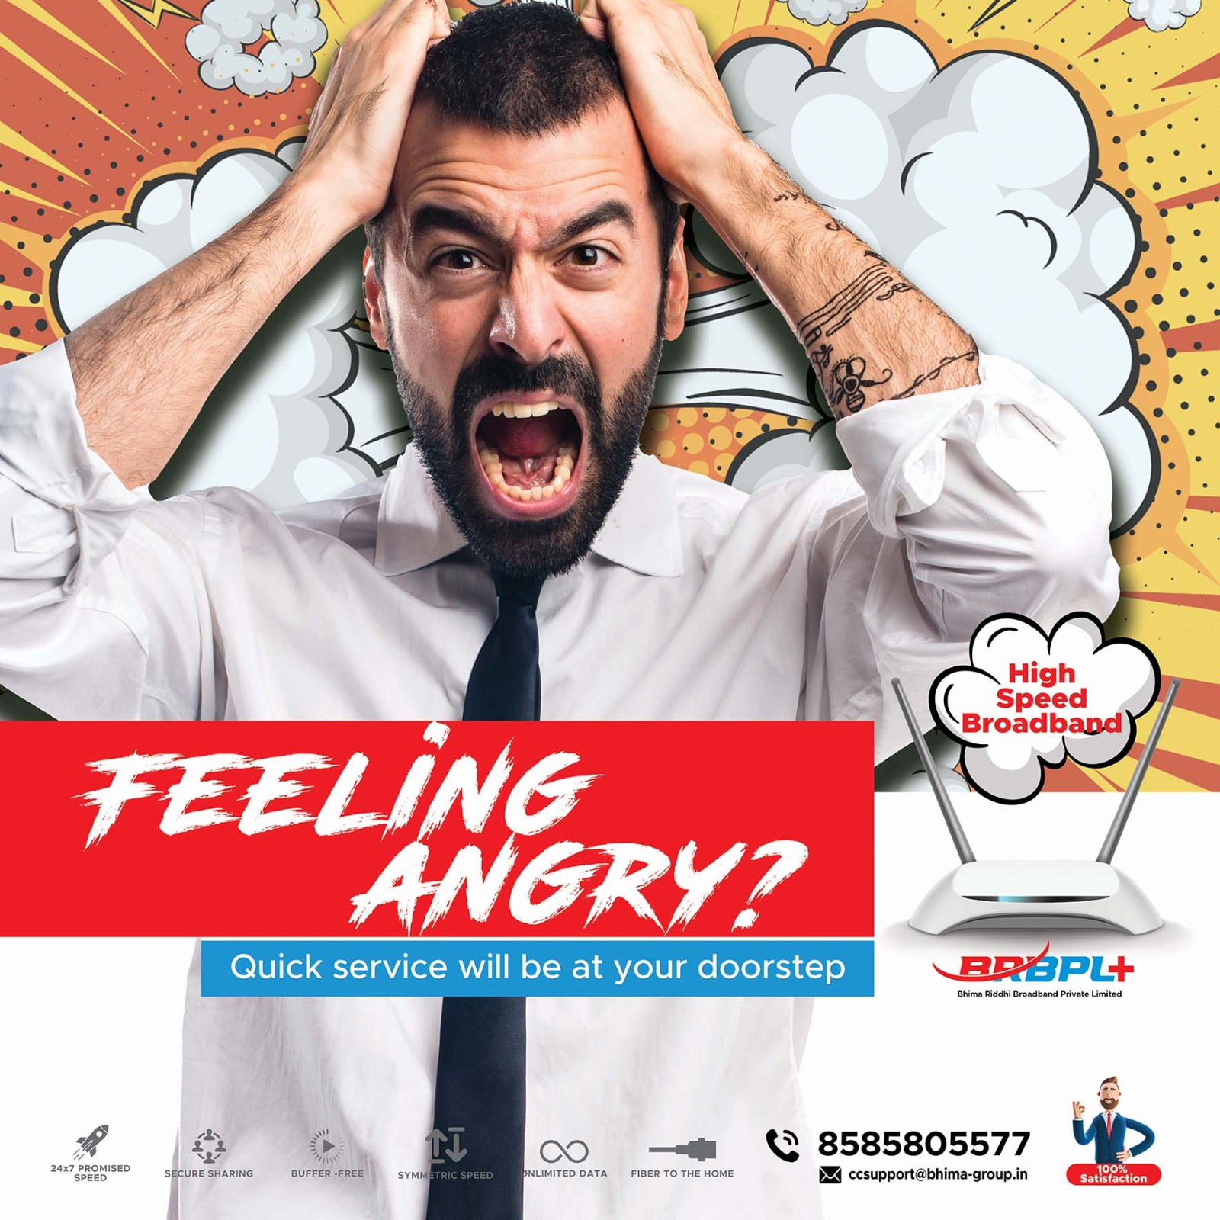

Slide 165
Bhima Internet Service across Maharashtra

Slide 166


Slide 167
Social Media Posts

Slide 169


Slide 170


Slide 171


Slide 172


Slide 173


Slide 174
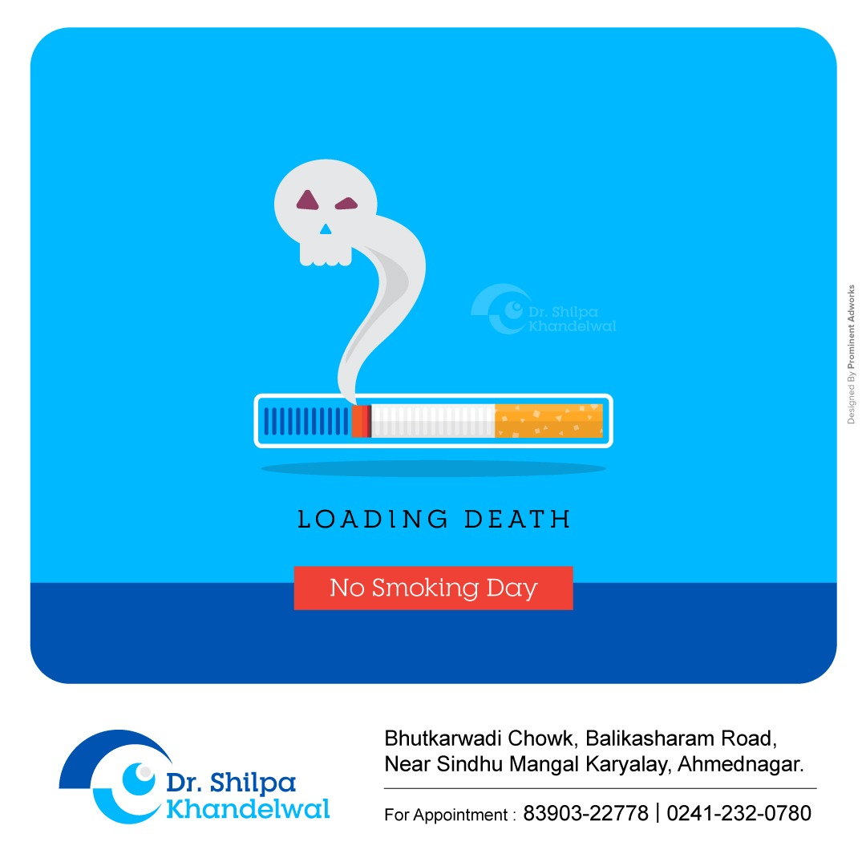

Slide 175


Slide 176


Slide 177


