Slide 1
KUNDAN – Eternia 2
(2 & 3 BHK Homes)
Hoardings

Slide 2


Slide 3


Slide 4


Slide 5
KUNDAN – PRAANGAN
(1, 2 & 3 BHK Homes)
Brochure cover

Slide 6


Slide 7


Slide 8
KURLON MATTRESS

Slide 9


Slide 10


Slide 11
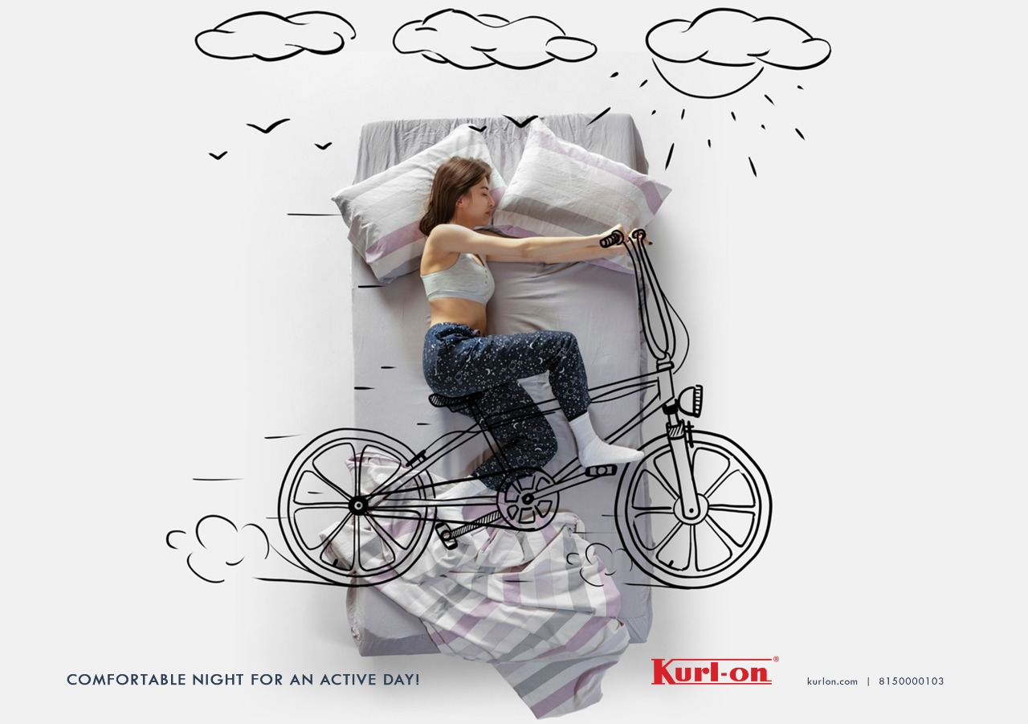

Slide 12


Slide 13
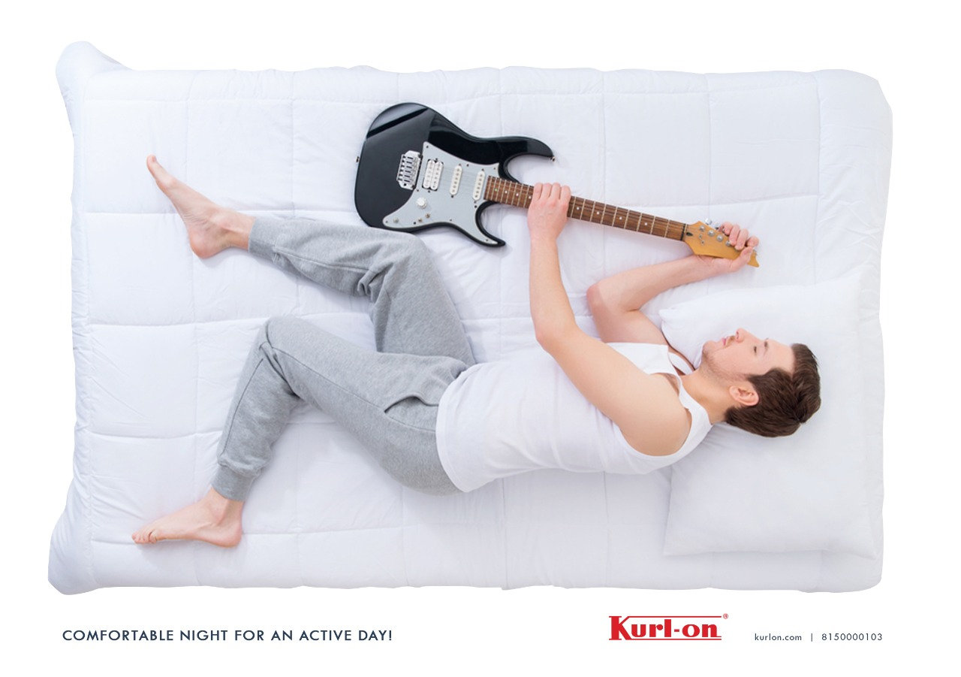

Slide 14
MERUSRI ONE VILLAS
Hoardings

Slide 15


Slide 16


Slide 17


Slide 18
KHUSHI AXIS WORLD
1 and 2BHK Homes

Slide 19


Slide 20


Slide 21


Slide 22
B:LIVE
Electric Bike

Slide 23


Slide 24


Slide 25


Slide 26
KHUSHI AXIS WORLD
1 & 2 BHK homes

Slide 27


Slide 28


Slide 29


Slide 30
TALENT EDGE
Concept 1

Slide 31


Slide 32


Slide 33


Slide 34
TALENT EDGE
Concept 2

Slide 35


Slide 36


Slide 37


Slide 38
METRO JUNCTION
(Shopping Mall)

Slide 39


Slide 40


Slide 41
Sunlit Grove
3 & 4BHK Villas

Slide 42


Slide 43


Slide 44
STIHL INDIA
(Agricultural equipment)
Independence Day Ad

Slide 45


Slide 46


Slide 47

STIHL
German Engineered equipment for farming,
lawn moving and vacuum cleaning

Slide 48
Merusri Serene
(3 Bed Villas)
Concept 1

Slide 49


Slide 50
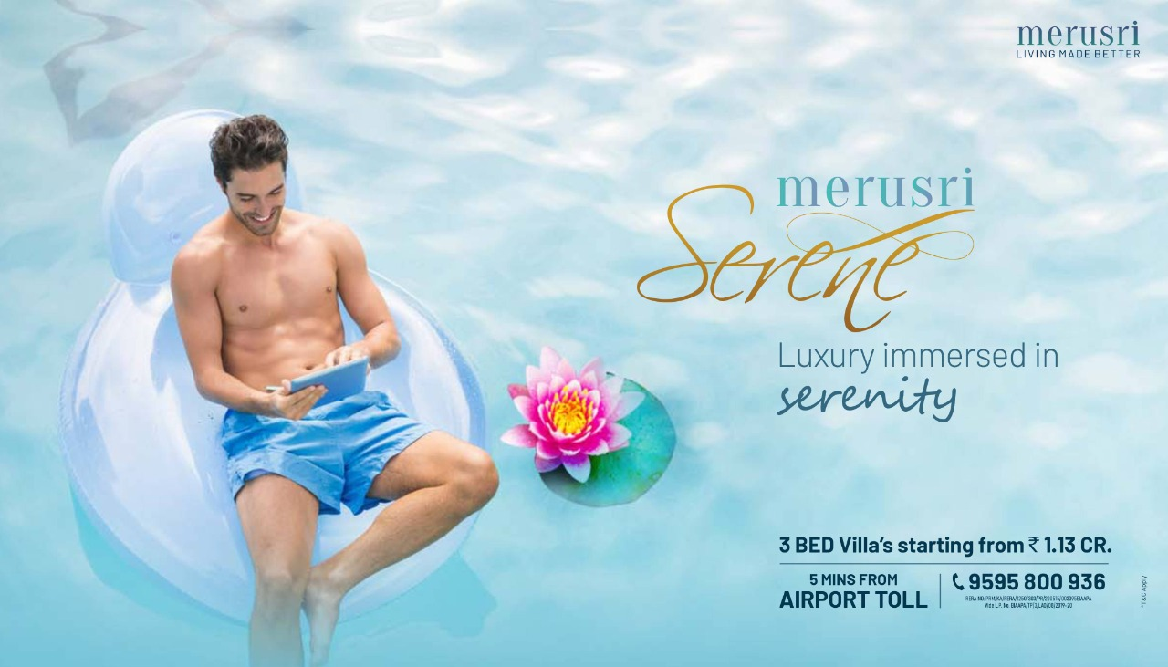

Slide 51


Slide 52
Merusri Serene
(3 Bed Villas)
Concept 2

Slide 53
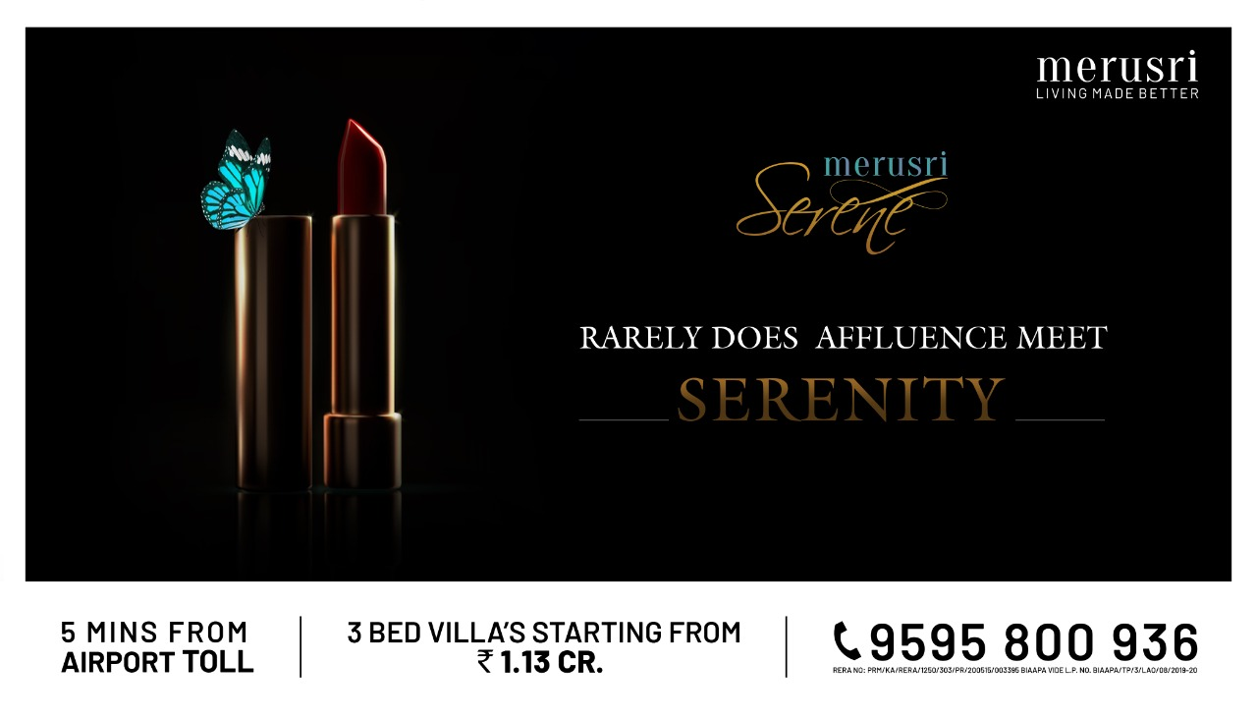

Slide 54
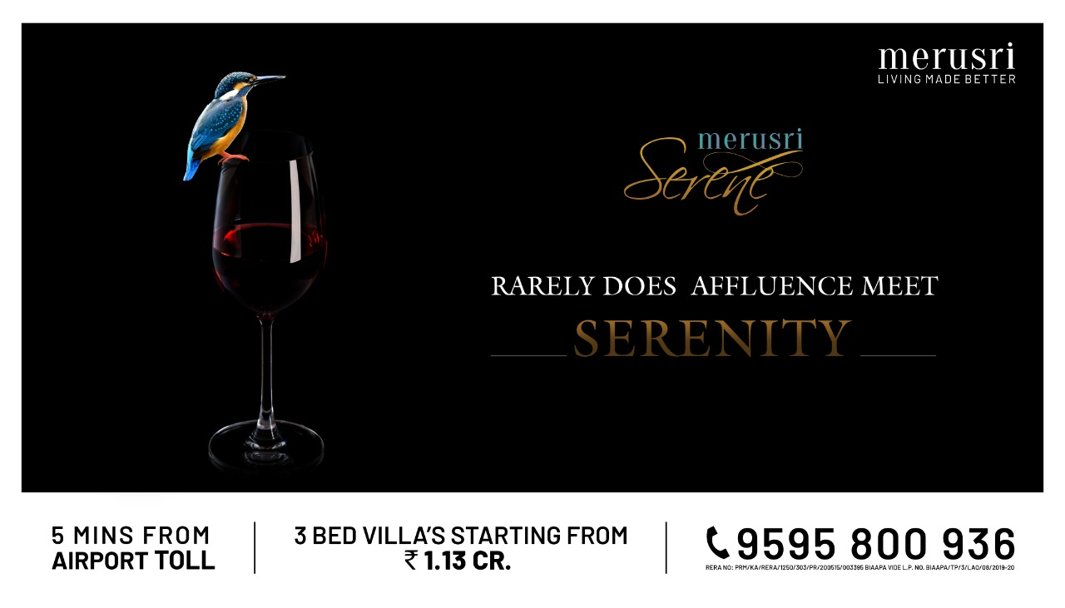

Slide 55
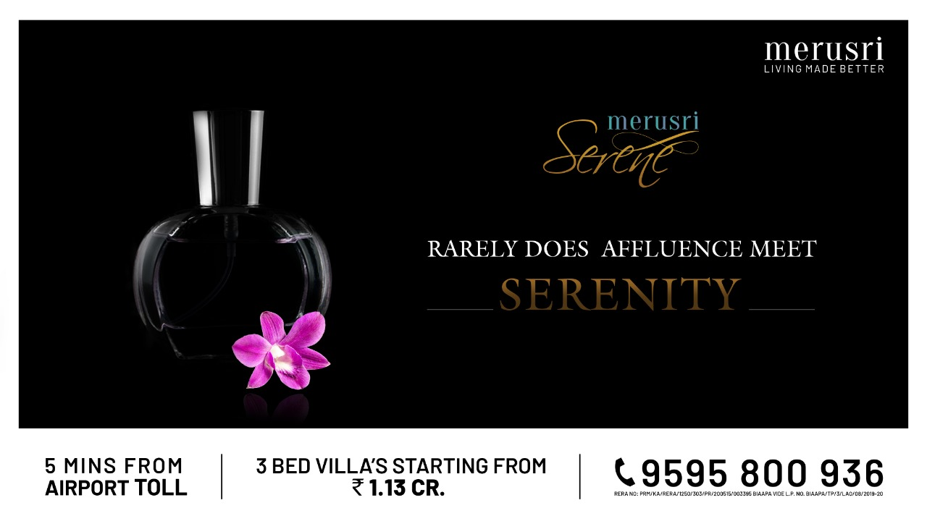

Slide 56
ELASTIC RUN
(B2B Logistics Firm)
CONCEPT 1

Slide 57


Slide 58


Slide 59


Slide 60
ELASTIC RUN
(B2B Logistics Firm)
CONCEPT 2

Slide 61

ELASTIC RUN
B2B Logistics Firm
CONCEPT 2

Slide 62


Slide 63
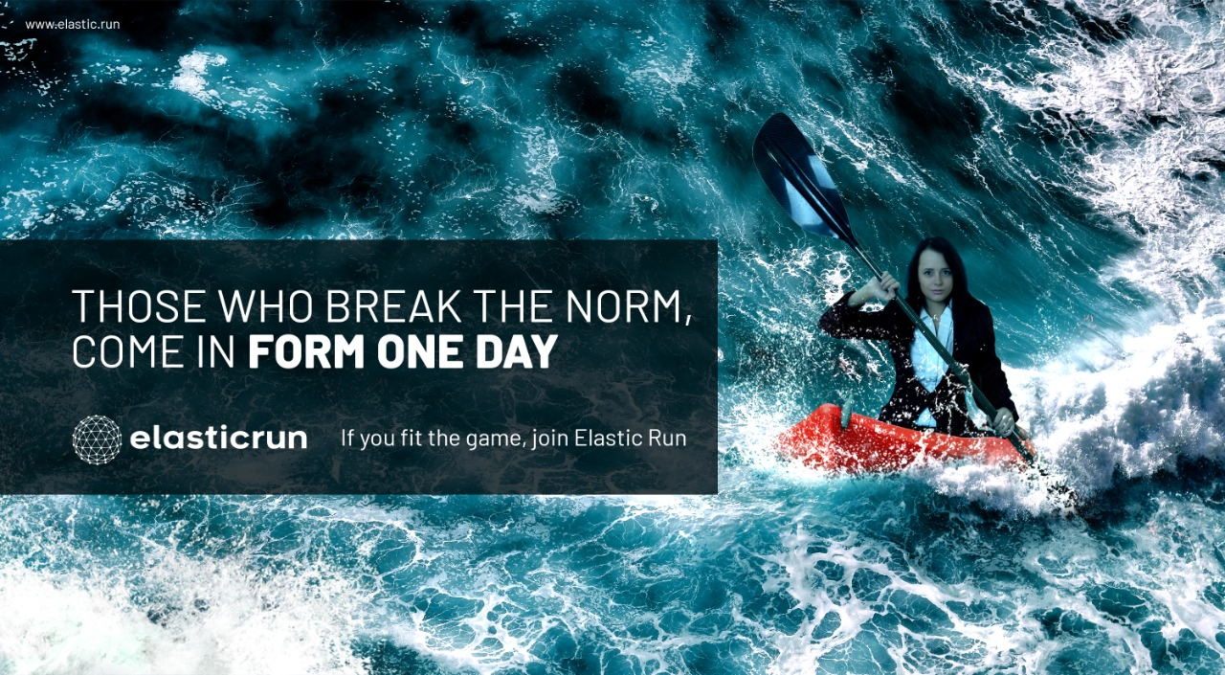

Slide 64
SUNLIT GROVE
(3 & 4 BHK Lavish Villas)

Slide 65


Slide 66


Slide 67


Slide 68
MEGAPOLIS
Integrated Township

Slide 69


Slide 70


Slide 71
PASHMINA WATERFRONT PENTHOUSES
Penthouses on 37th & 38th floor

Slide 72
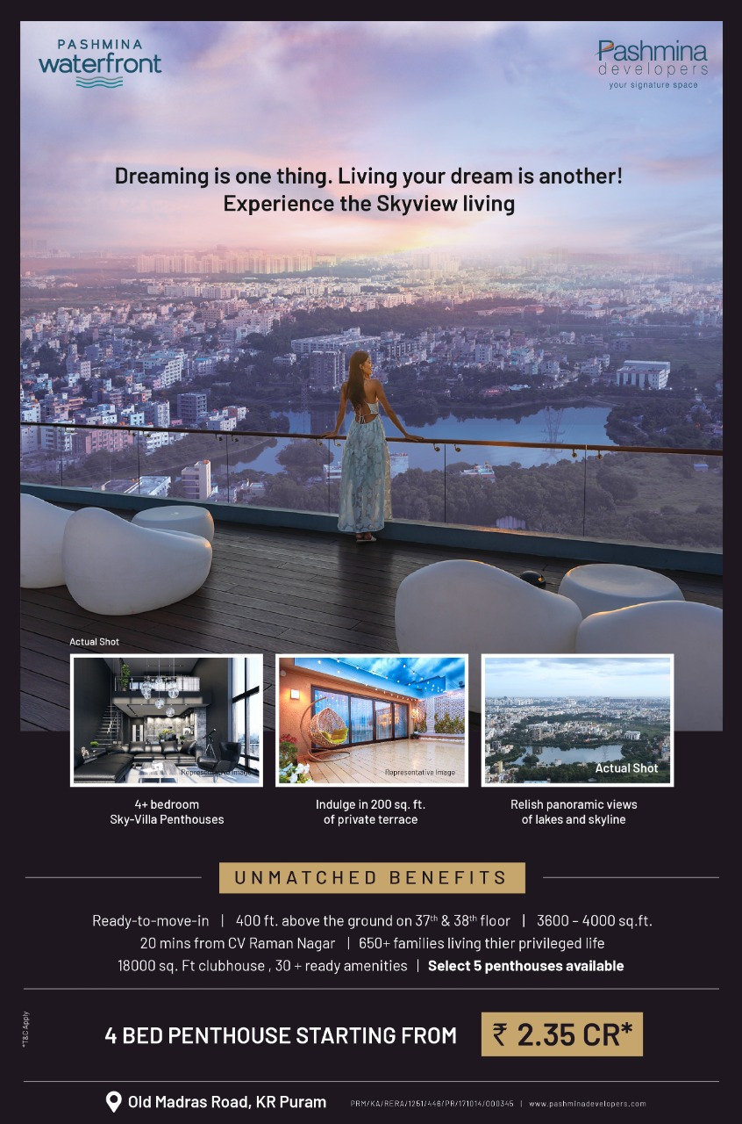

Slide 73


Slide 74
Snow Kingdom
(Snow Theme Park)
Rebranding Campaign

Slide 75
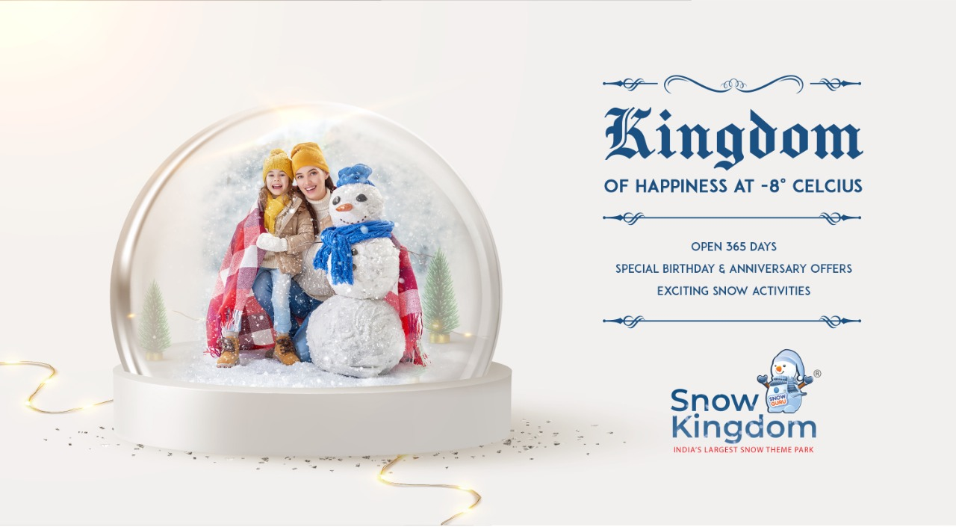

Slide 76
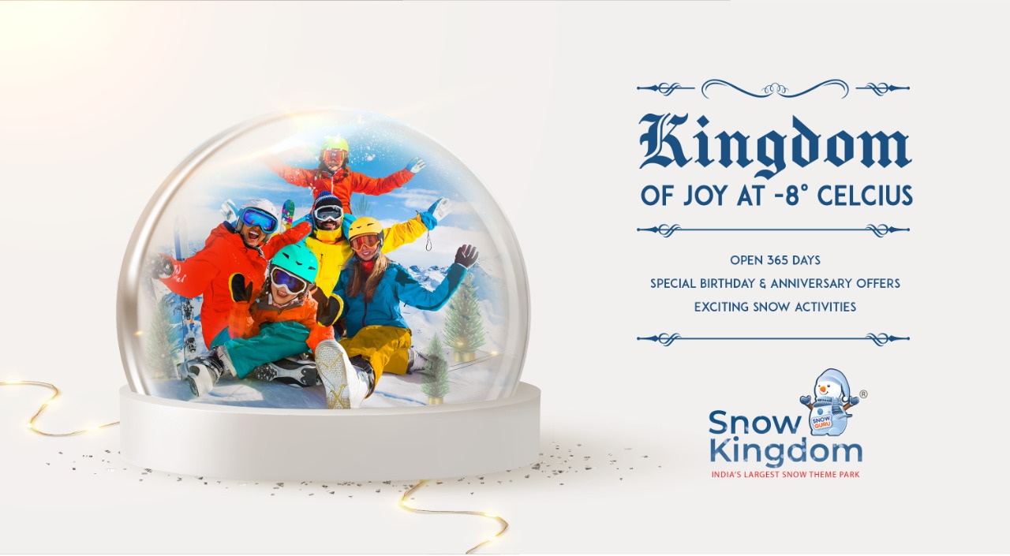

Slide 77
Snow Kingdom
(Snow Theme Park)
Hyderabad Launch Campaign

Slide 78


Slide 79


Slide 80


Slide 81
KUMAR CORP
(Real Estate)
Corporate Campaign

Slide 82


Slide 83


Slide 84


Slide 85
Continental Futura
Child Centric – 1 & 2 BHK Homes

Slide 86


Slide 87


Slide 88


Slide 89
Continental Futura
1 & 2 BHK Homes

Slide 90


Slide 91


Slide 92


Slide 93
YOO ONE
(Ultra Premium Homes)
Concept 1

Slide 94


Slide 95


Slide 96


Slide 97
YOO ONE
(Ultra Premium Homes)
Concept 2

Slide 98


Slide 99


Slide 100


Slide 101
STIHL INDIA
(Genuine Parts Ad)

Slide 102


Slide 103
STIHL INDIA
(Lawn Mower Ad)

Slide 104
JBJ
(Jewellery Brand)

Slide 105


Slide 106


Slide 107
Vaibhavlaxmi Developers
(Real Estate Brand)

Slide 108


Slide 109
WAKAU
Short video sharing social media app

Slide 110
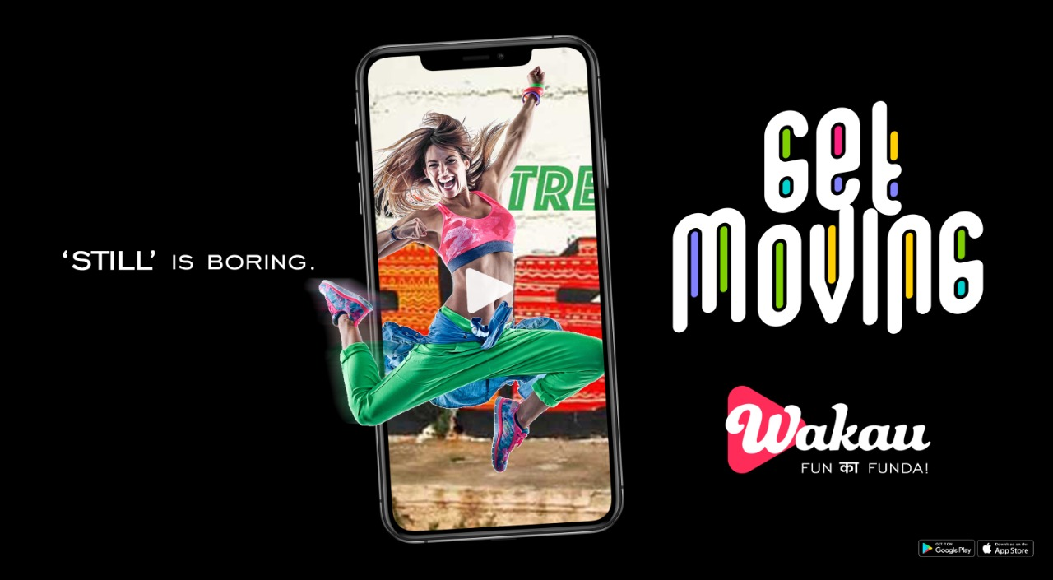

Slide 111


Slide 112
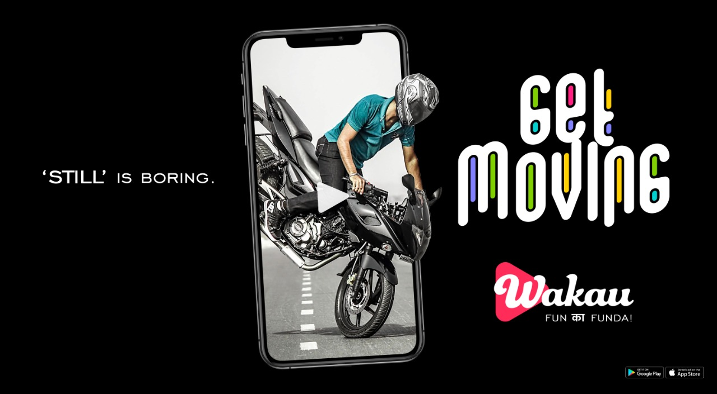

Slide 113
WAKAU
Short video sharing social media app

Slide 114


Slide 115


Slide 116
WAKAU
Short video sharing social media app
CONCEPT 3

Slide 117


Slide 118


Slide 119
PASHIMINA WATERFRONT
3 BHK apartments & 4 Bed penthouses

Slide 120
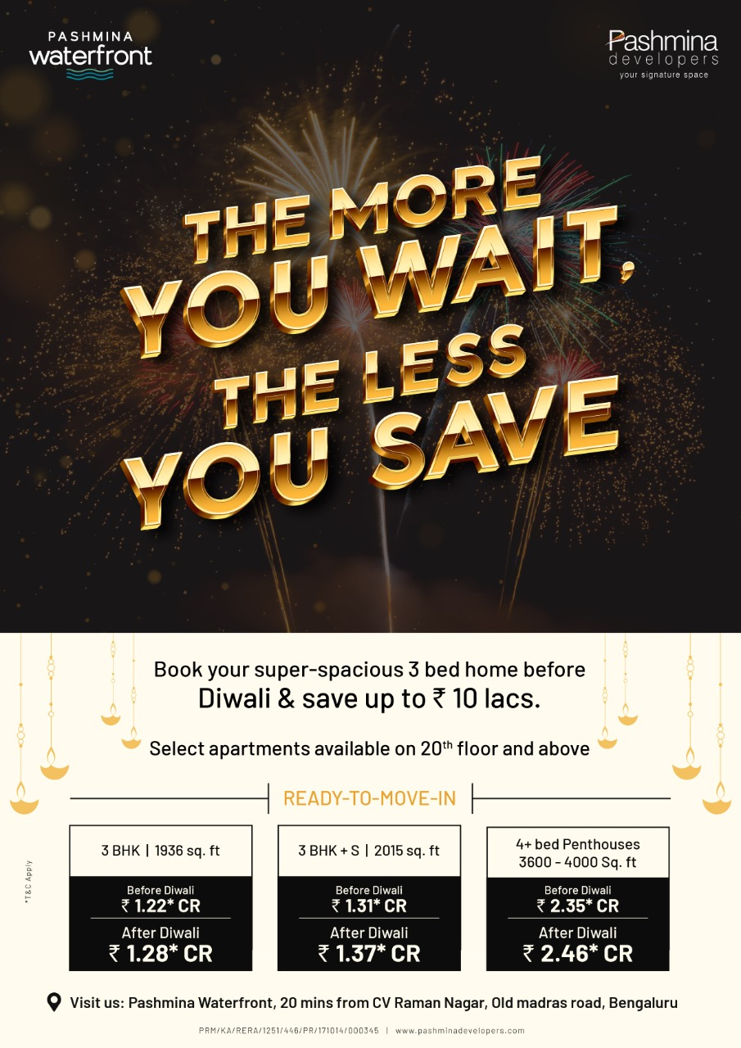

Slide 121
STIHL
Agriculture & cleaning equipment

Slide 122


Slide 123


Slide 124


Slide 125
VAIBHAVLAMI JEWELLERS

Slide 126


Slide 127


Slide 128


Slide 129


Slide 130
WAKAU
Social Media Short Video Sharing App
(Campaign 1)

Slide 134
WAKAU
Social Media Short Video Sharing App
(Campaign 1)

Slide 135


Slide 136


Slide 137
Real Estate
Panvelkar Greens
1 and 2 BHK Homes

Slide 138
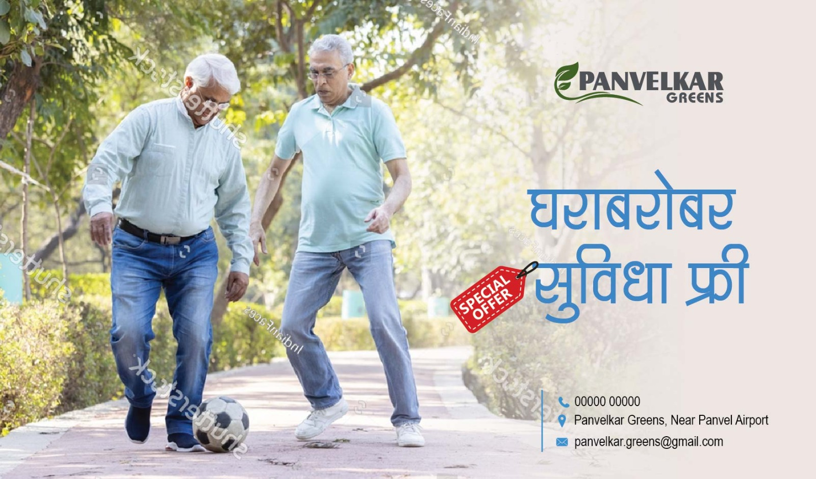

Slide 139


Slide 140


Slide 141
ARATT GROUP
Real Estate
Corporate Campaign

Slide 142
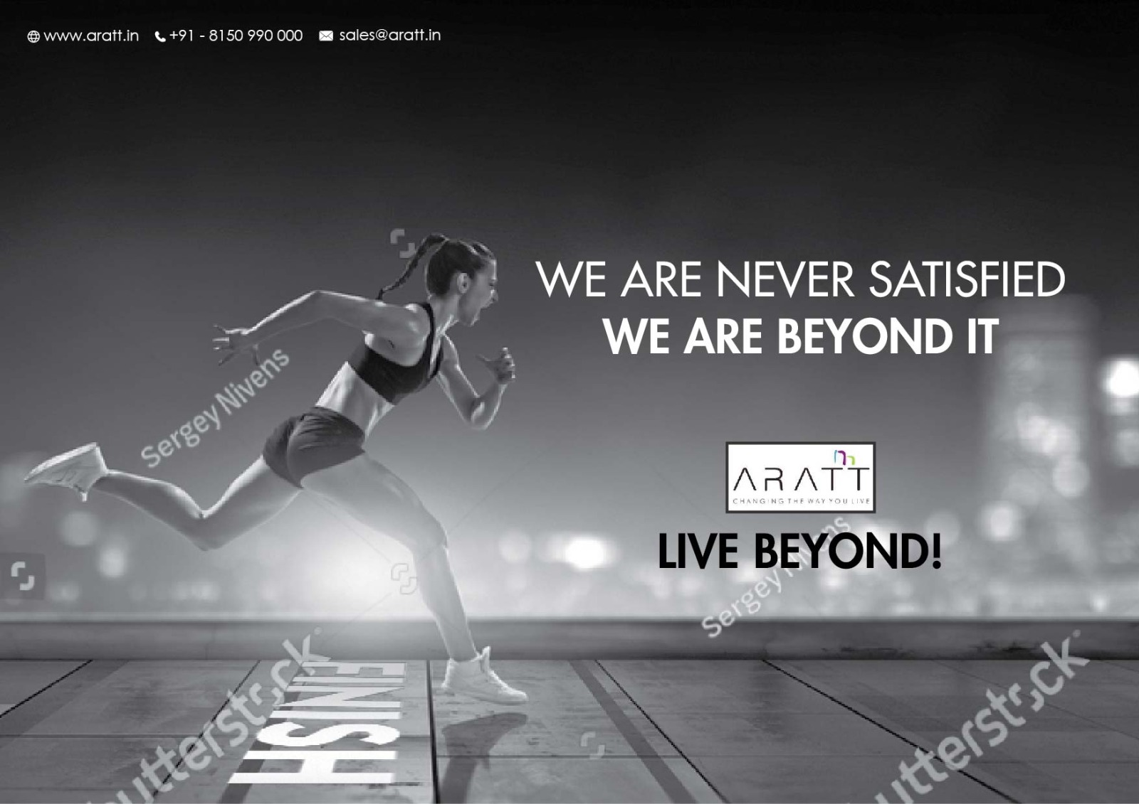

Slide 143


Slide 144
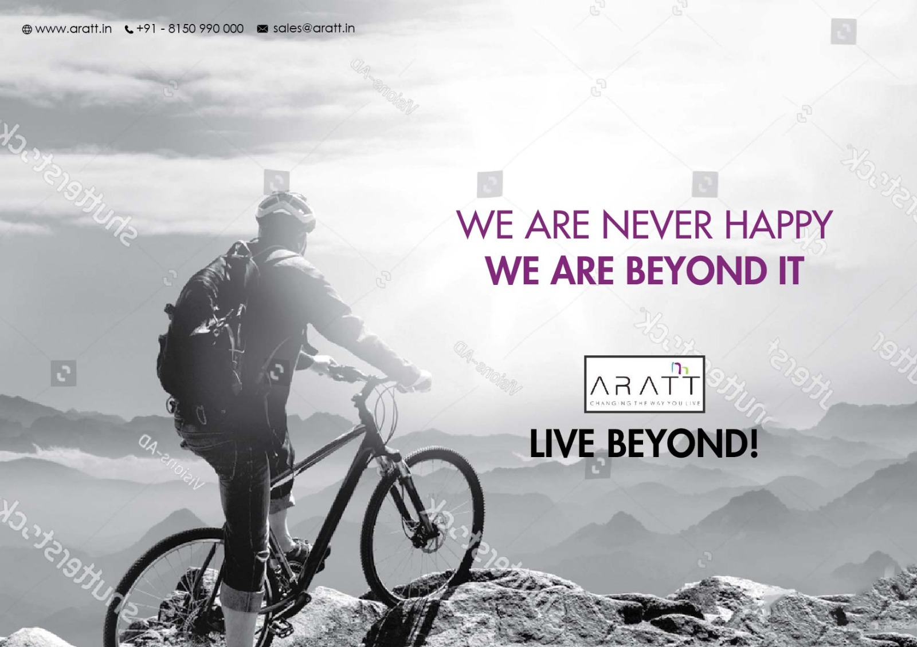

Slide 145
Westend Mall
Jeans and Sneakers Fest

Slide 146


Slide 147


Slide 148
Real Estate
Project – Panvelkar Greens

Slide 149


Slide 150


Slide 151


Slide 152
Real Estate

Slide 153


Slide 154
Father’s Day ads for jewellers

Slide 155


Slide 156


Slide 157


Slide 158
Bhima Internet Service across Maharashtra

Slide 159


Slide 160


Slide 161


Slide 162
Bhima Internet Service across Maharashtra

Slide 163


