Slide 1
All the English copy, concepts, visualization, and ideation along with 70% design is by me.

Slide 2
KUNDAN – Eternia 2
(2 & 3 BHK Homes)
Hoardings

Slide 3
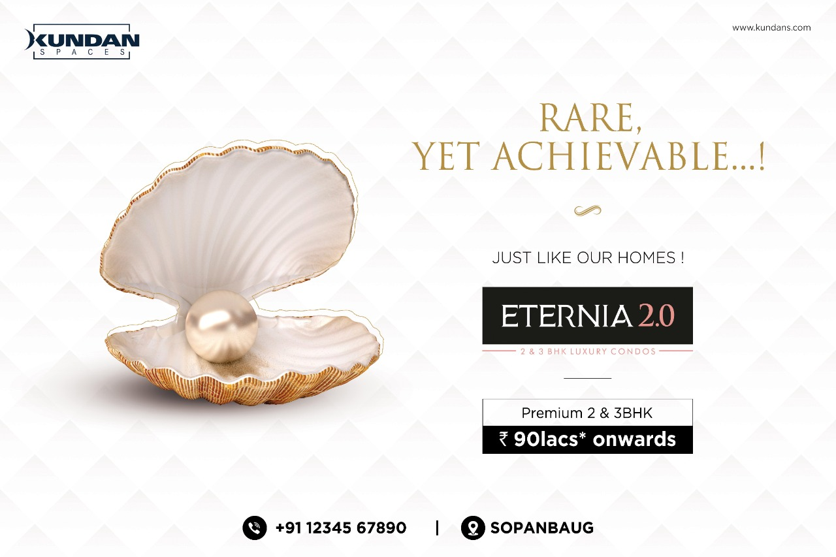

Slide 4
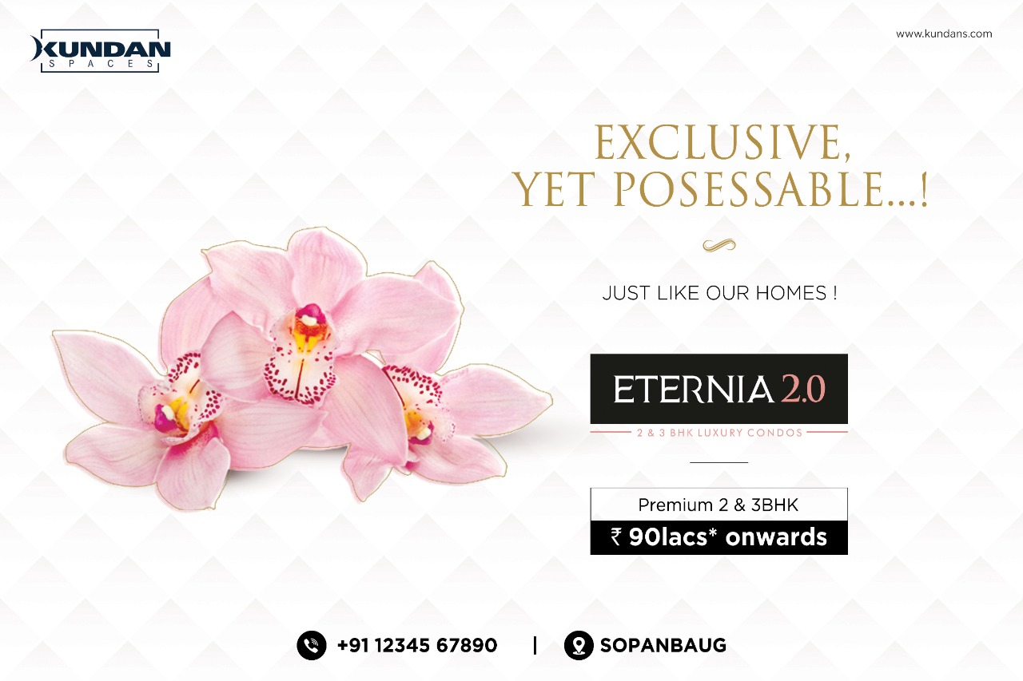

Slide 5


Slide 6
KUNDAN – PRAANGAN
(1, 2 & 3 BHK Homes)
Brochure cover

Slide 7


Slide 8


Slide 9
KURLON MATTRESS

Slide 10
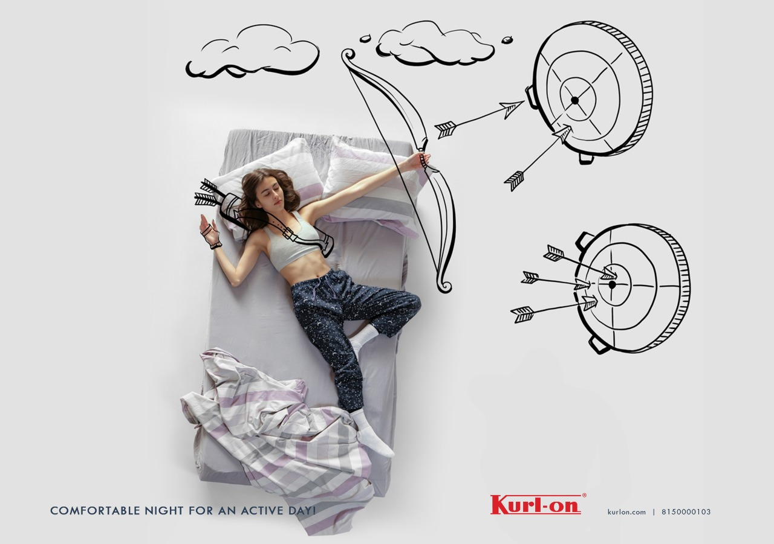

Slide 11
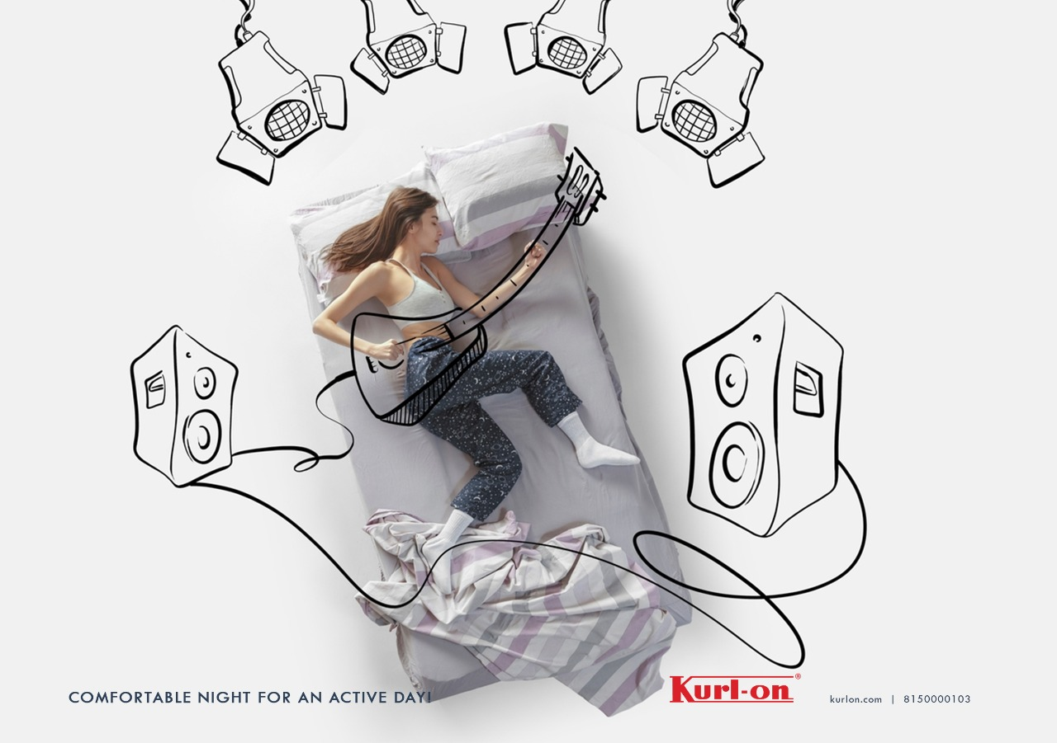

Slide 12
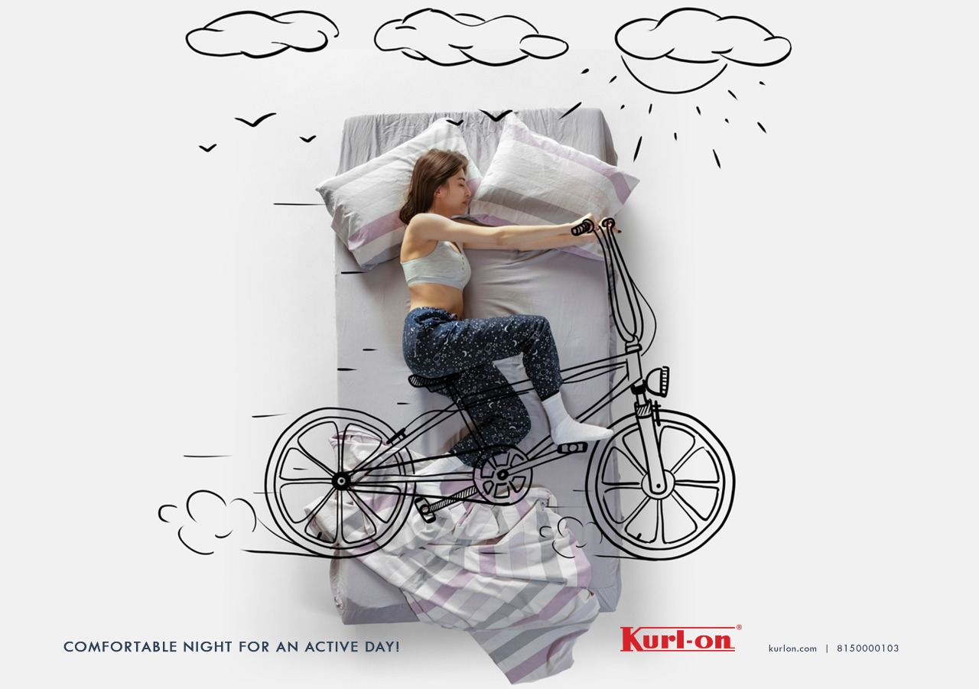

Slide 13
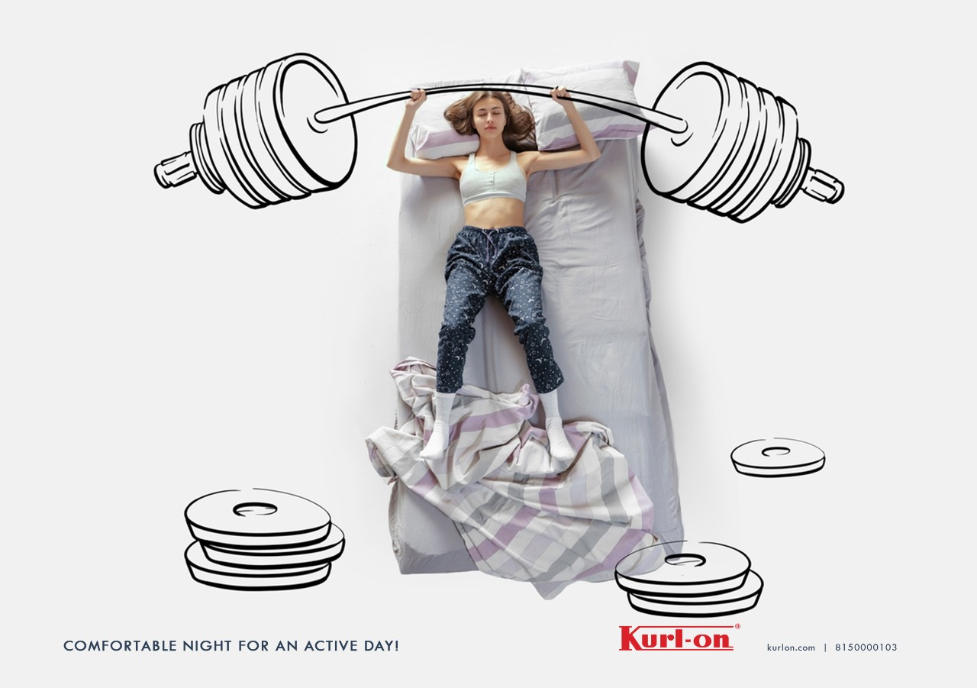

Slide 14
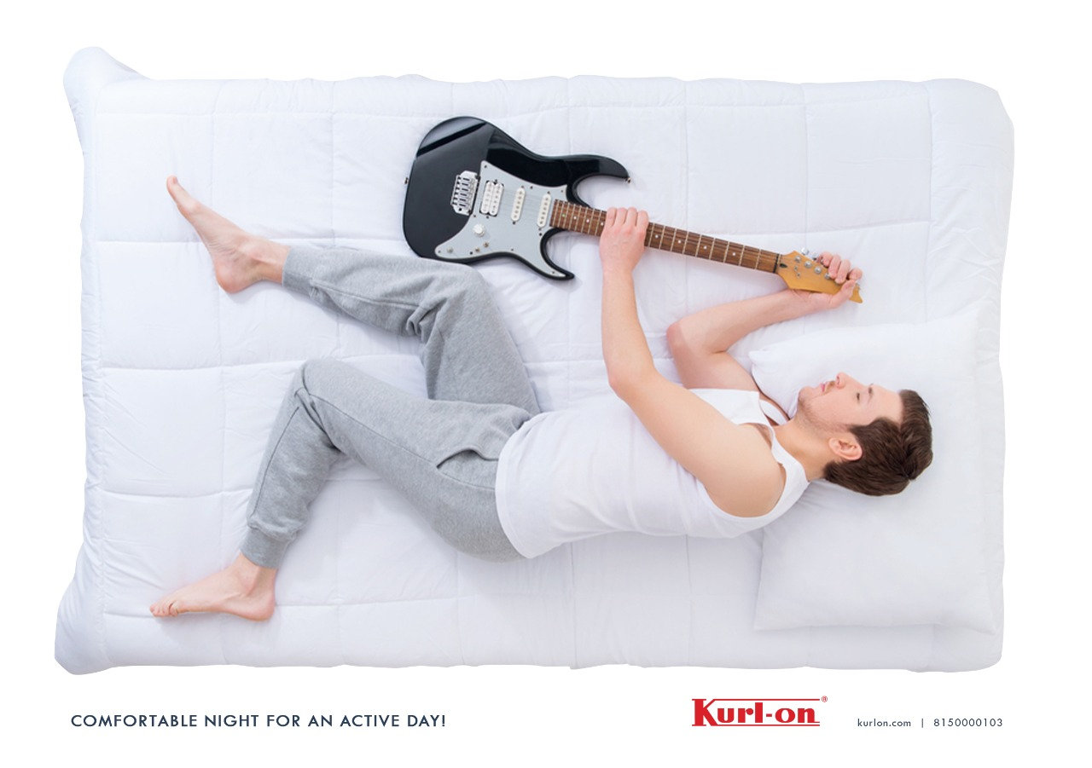

Slide 15
MERUSRI ONE VILLAS
Hoardings

Slide 16
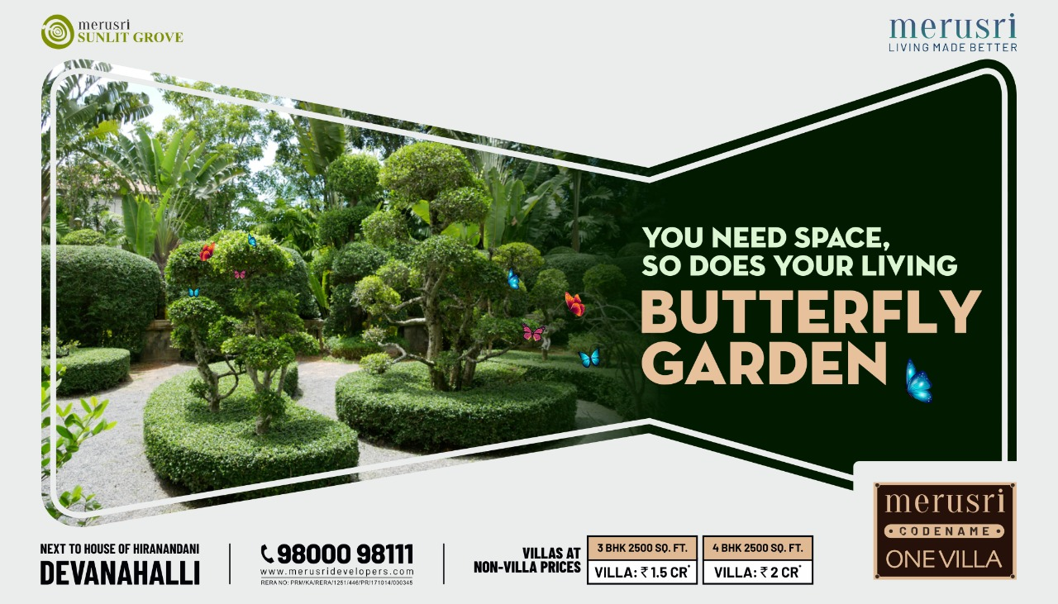

Slide 17
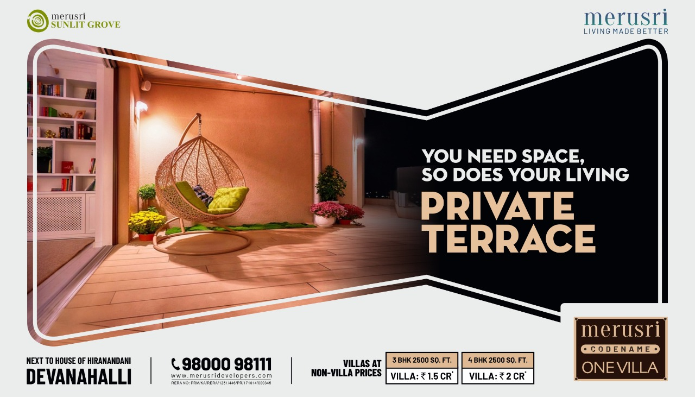

Slide 18
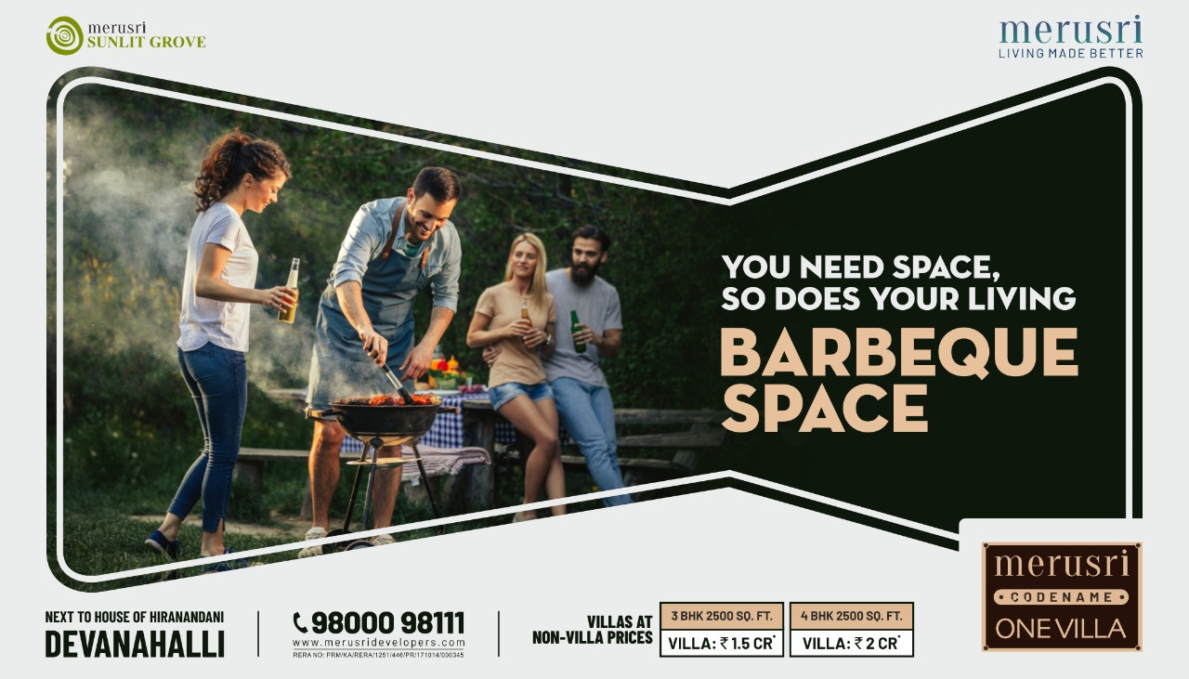

Slide 19
KHUSHI AXIS WORLD
1 and 2BHK Homes

Slide 20
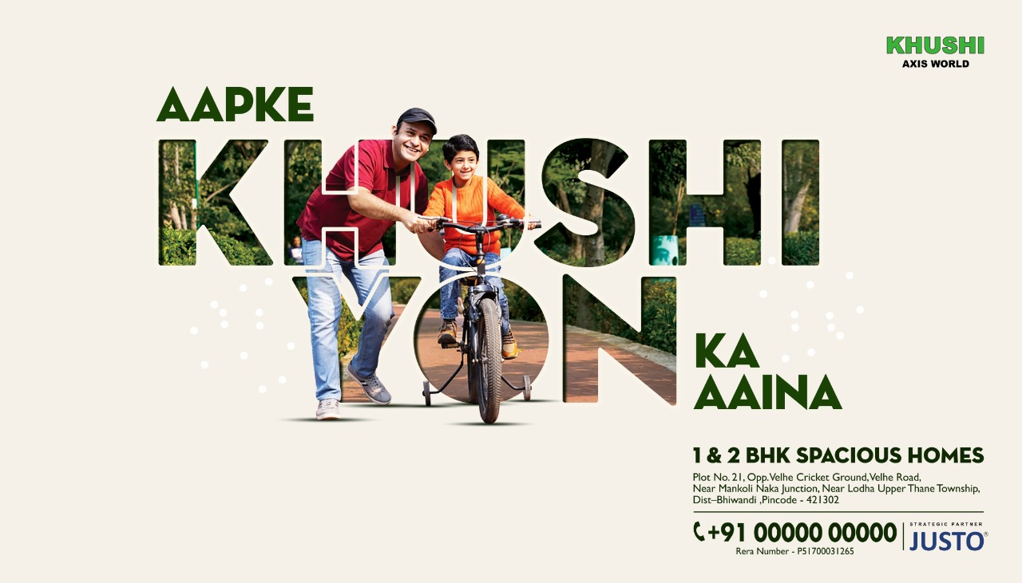

Slide 21


Slide 22


Slide 23
B:LIVE
Electric Bike

Slide 24
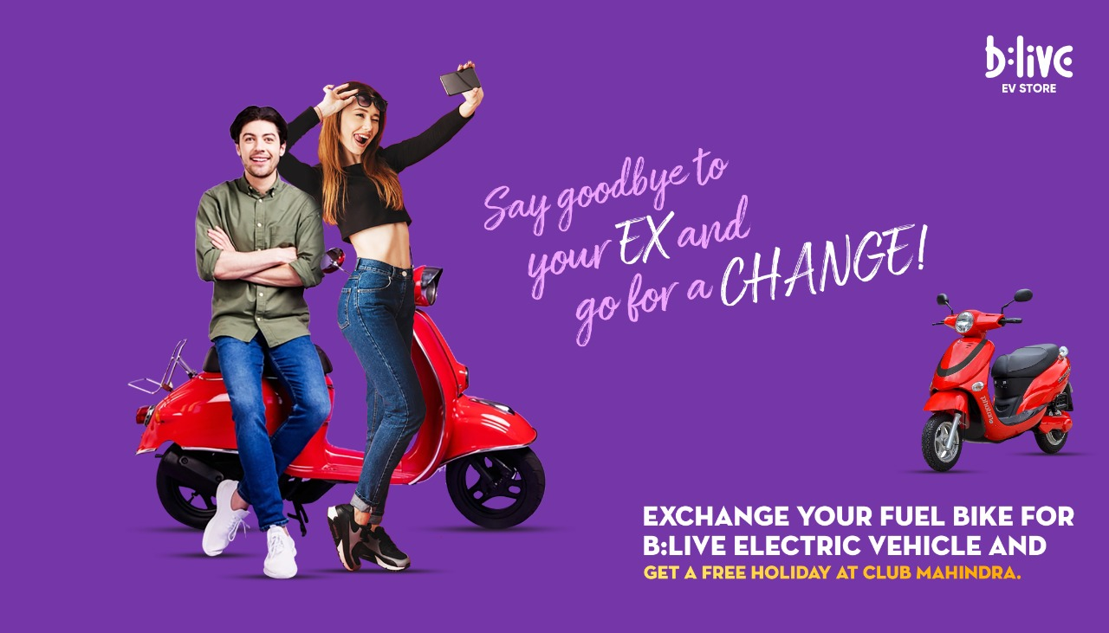

Slide 25
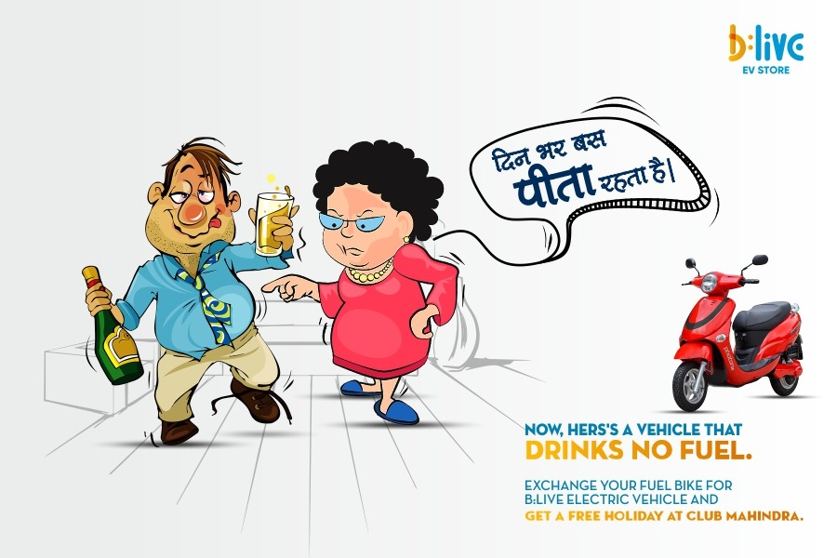

Slide 26
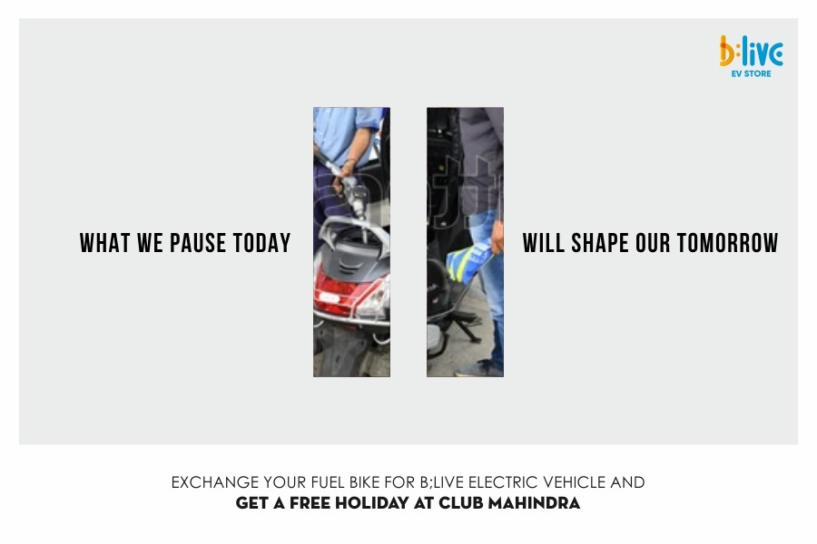

Slide 27
KHUSHI AXIS WORLD
1 & 2 BHK homes

Slide 28


Slide 29
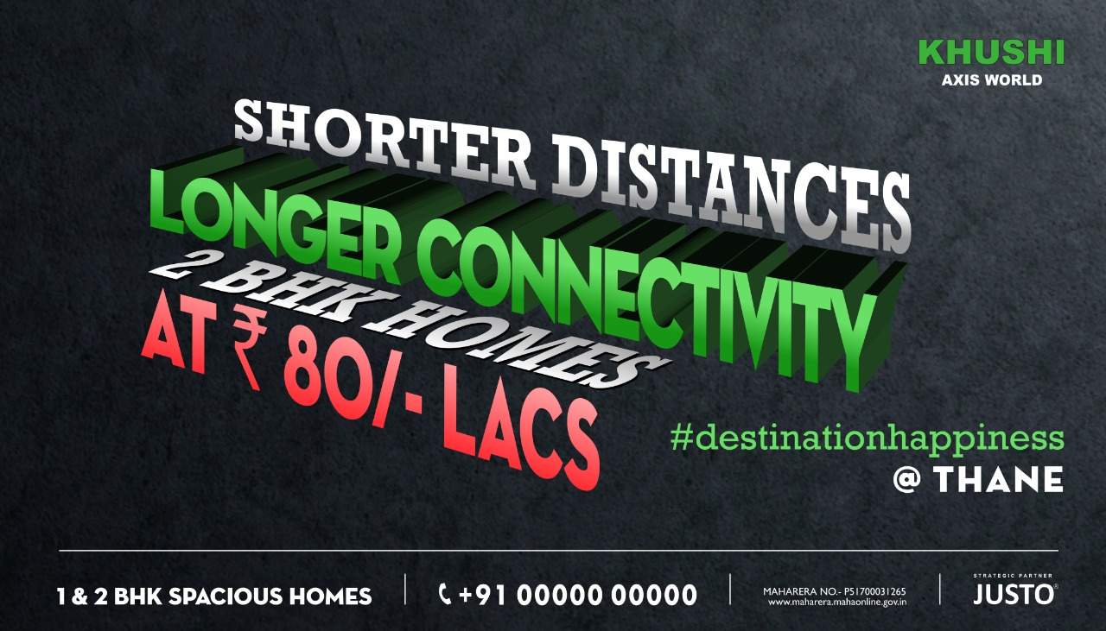

Slide 30
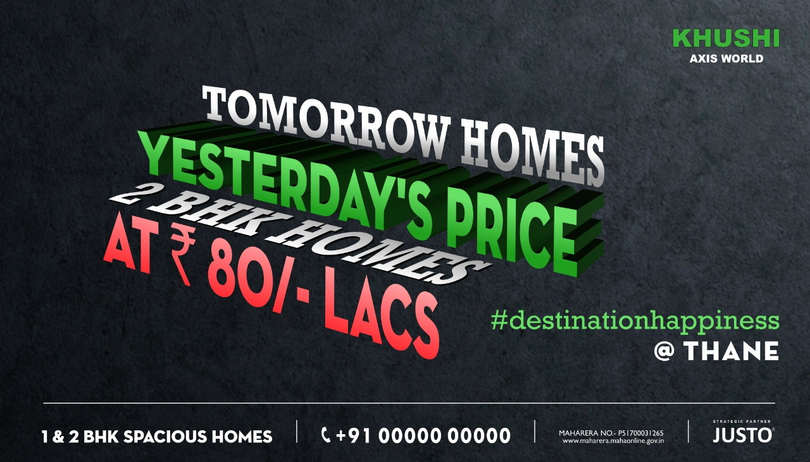

Slide 31
TALENT EDGE
Concept 1

Slide 32


Slide 33


Slide 34


Slide 35
TALENT EDGE
Concept 2

Slide 36


Slide 37


Slide 38
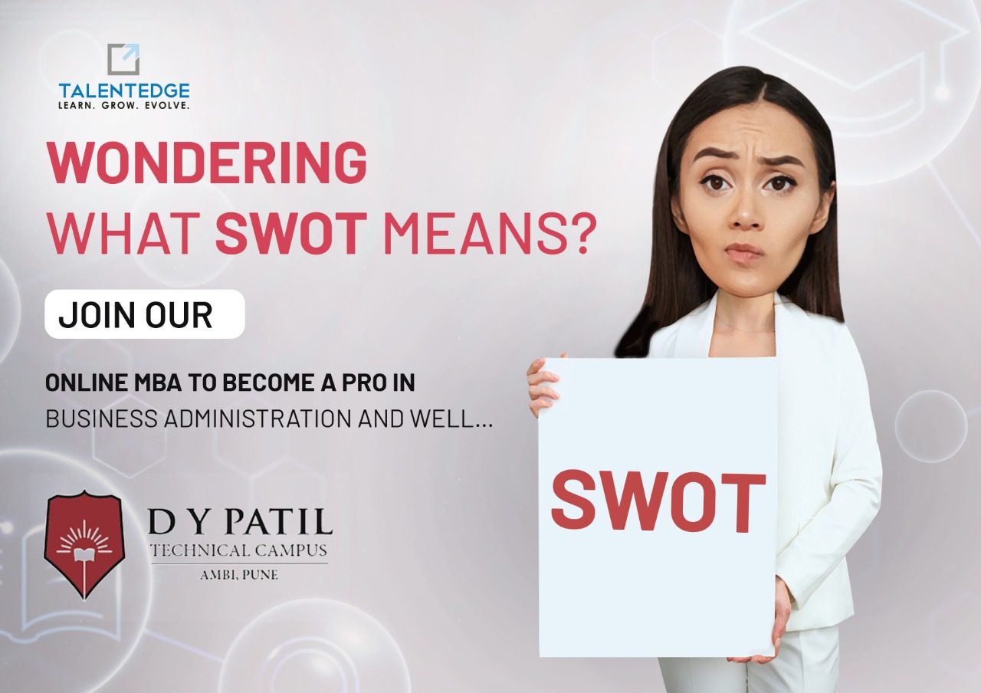

Slide 39
METRO JUNCTION
(Shopping Mall)

Slide 40


Slide 41


Slide 42
Sunlit Grove
3 & 4BHK Villas

Slide 43
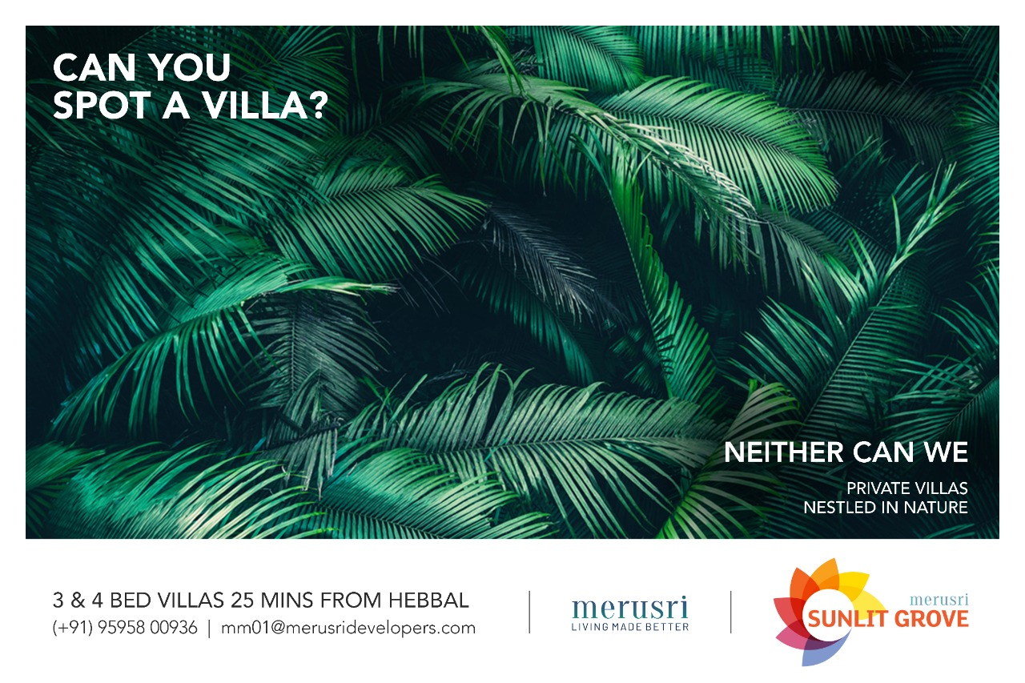

Slide 44
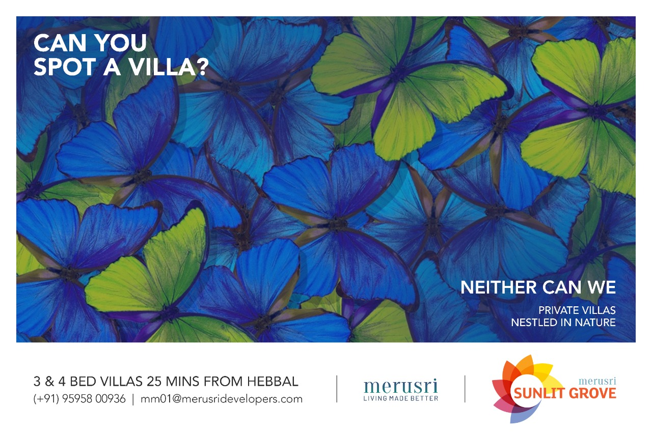

Slide 45
STIHL INDIA
(Agricultural equipment)
Independence Day Ad

Slide 46


Slide 47
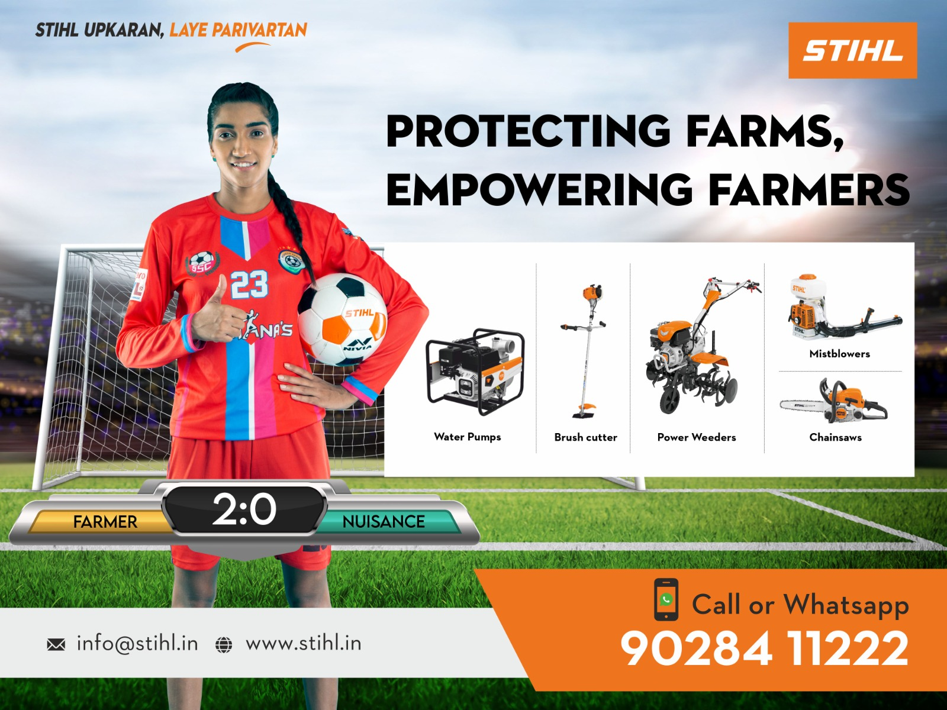

Slide 48

STIHL
German Engineered equipment for farming,
lawn moving and vacuum cleaning

Slide 49
Merusri Serene
(3 Bed Villas)
Concept 1

Slide 50
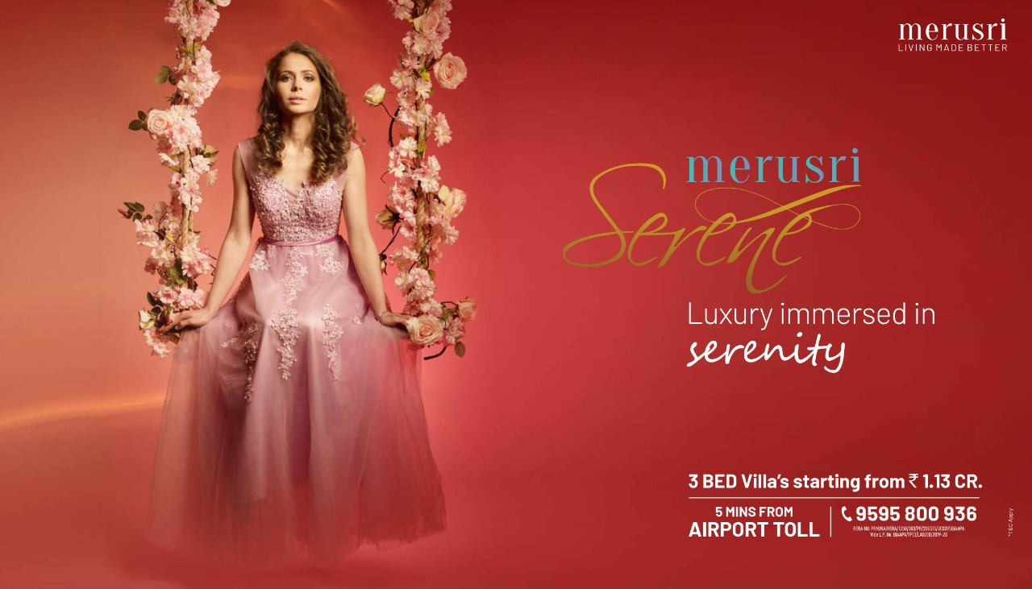

Slide 51
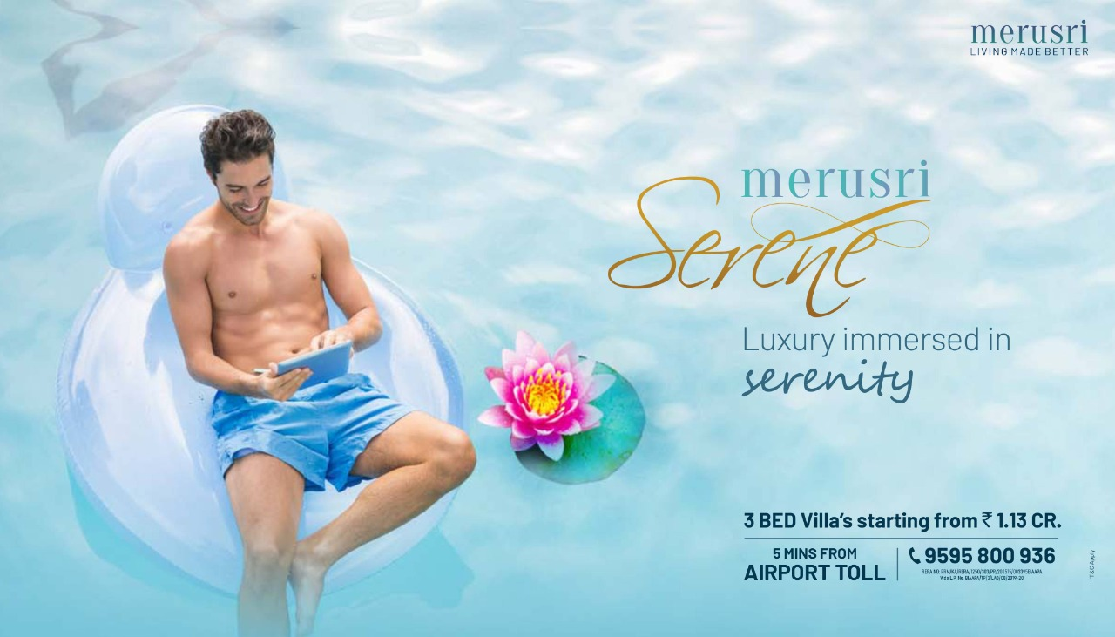

Slide 52


Slide 53
Merusri Serene
(3 Bed Villas)
Concept 2

Slide 54
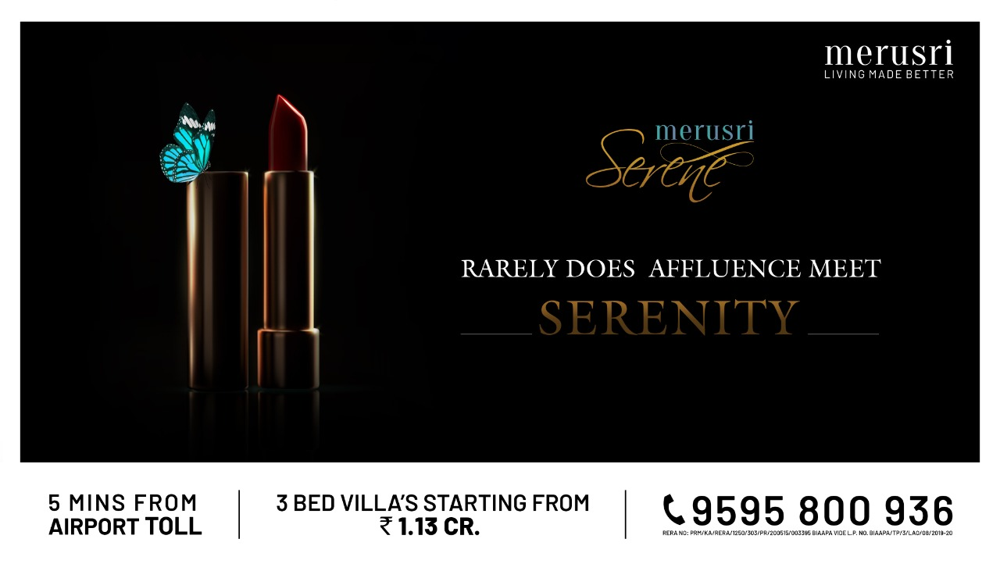

Slide 55
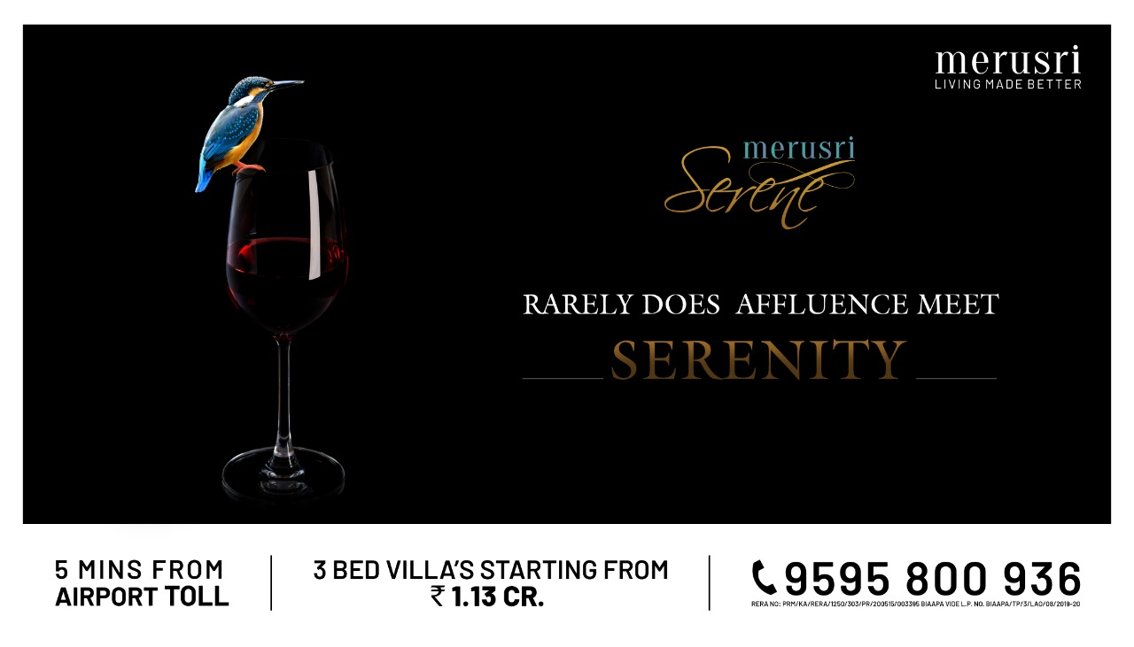

Slide 56
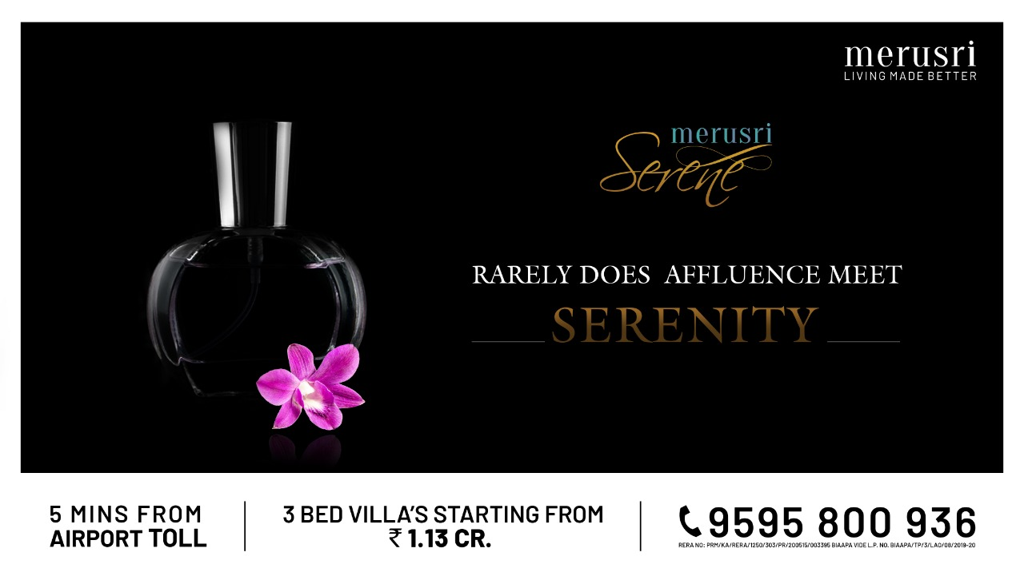

Slide 57
ELASTIC RUN
(B2B Logistics Firm)
CONCEPT 1

Slide 58


Slide 59


Slide 60


Slide 61
ELASTIC RUN
(B2B Logistics Firm)
CONCEPT 2

Slide 62
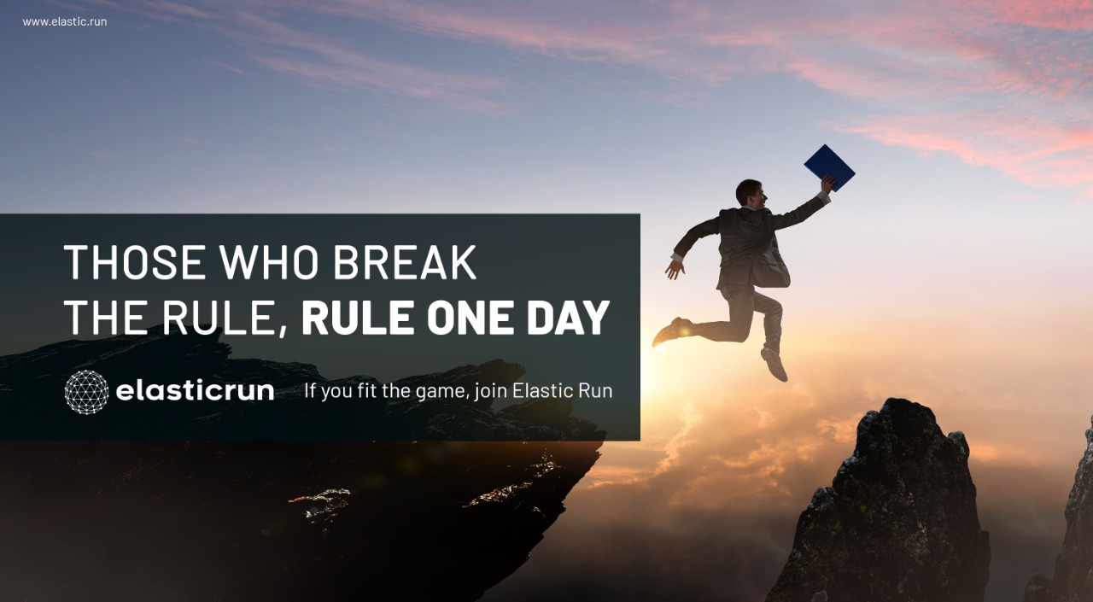
ELASTIC RUN
B2B Logistics Firm
CONCEPT 2

Slide 63
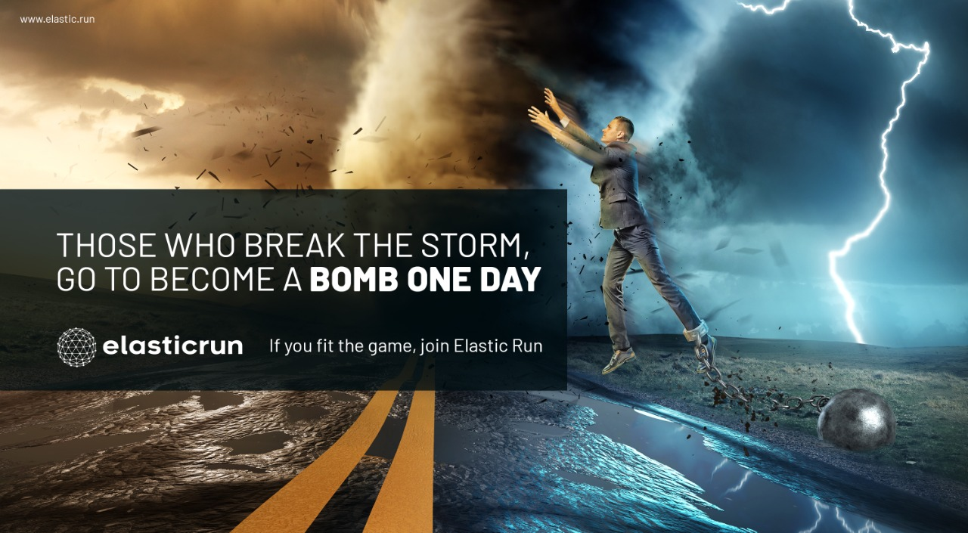

Slide 64
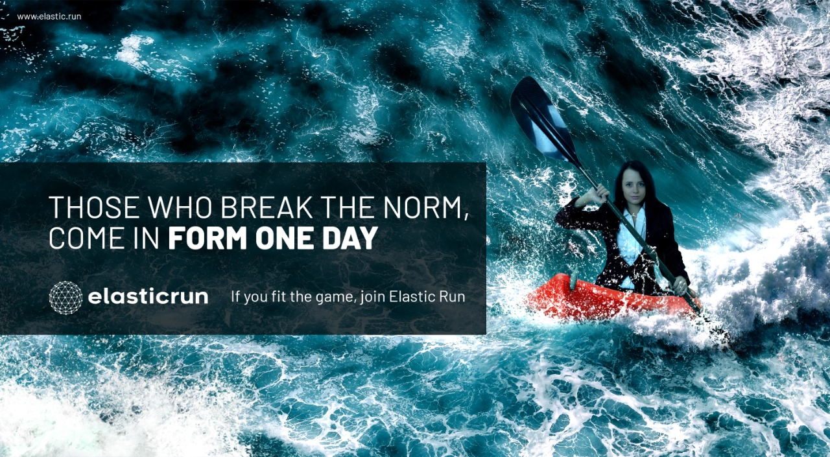

Slide 65
SUNLIT GROVE
(3 & 4 BHK Lavish Villas)

Slide 66


Slide 67
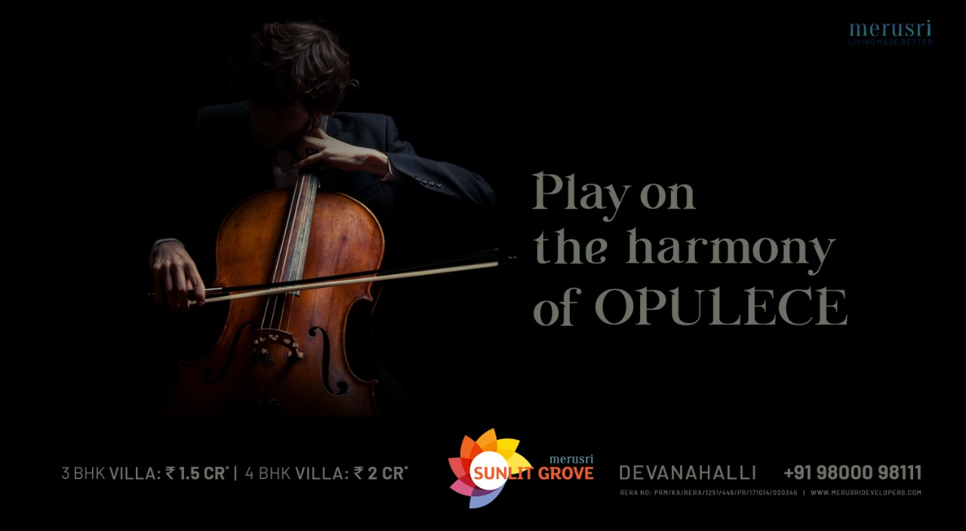

Slide 68


Slide 69
MEGAPOLIS
Integrated Township

Slide 70
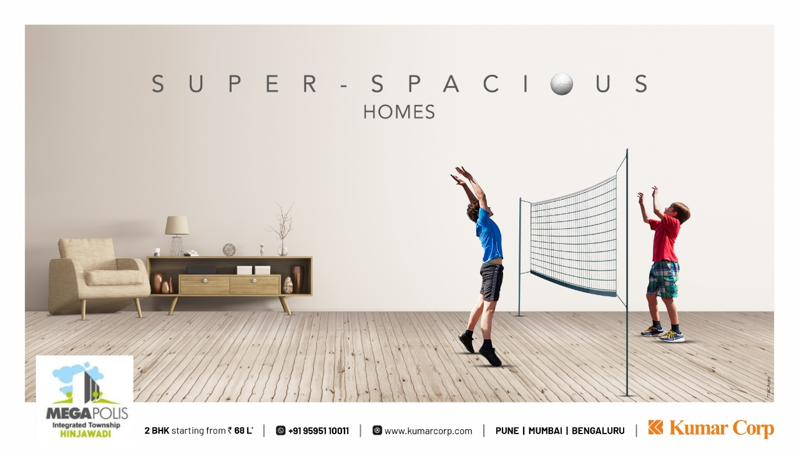

Slide 71
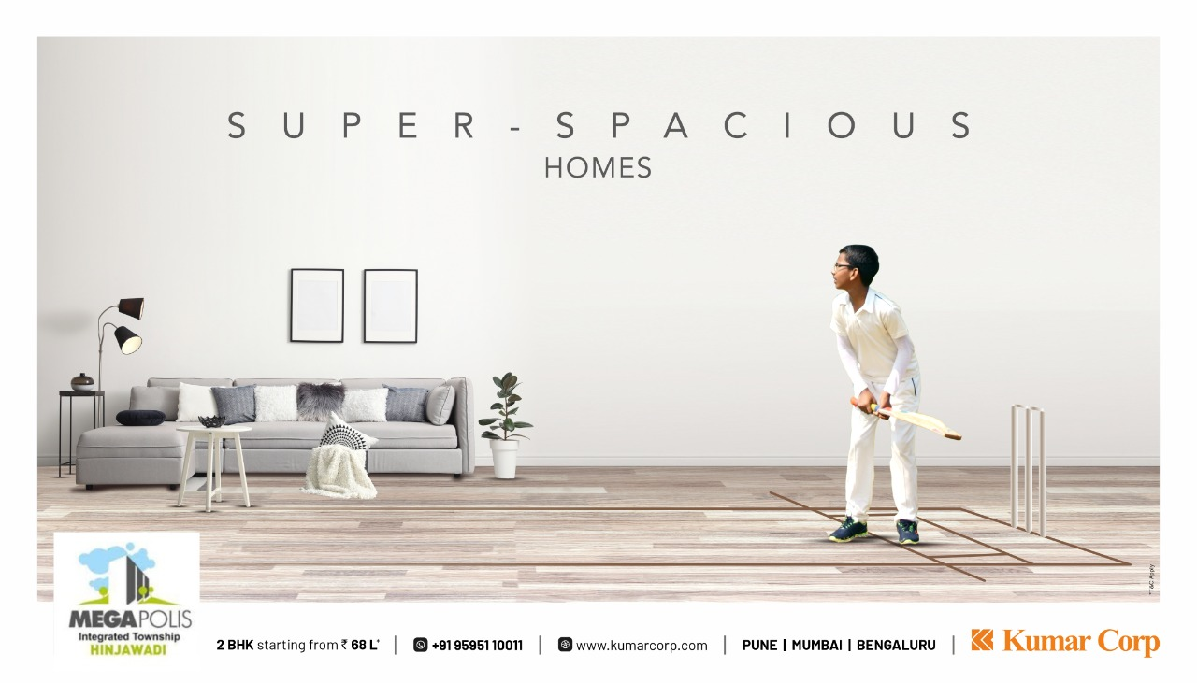

Slide 72
PASHMINA WATERFRONT PENTHOUSES
Penthouses on 37th & 38th floor

Slide 73
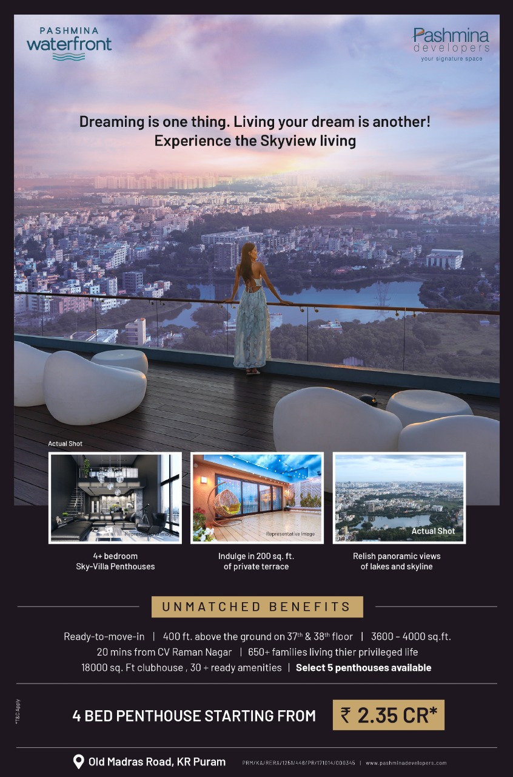

Slide 74
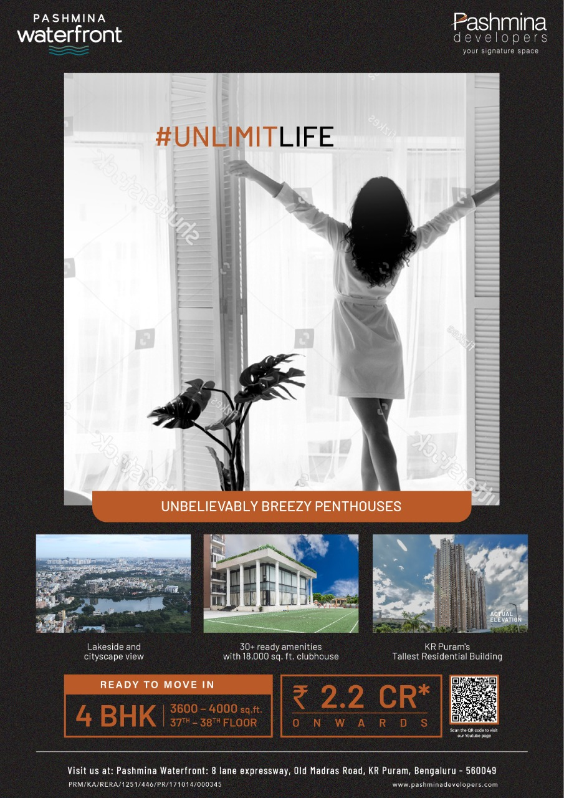

Slide 75
Snow Kingdom
(Snow Theme Park)
Rebranding Campaign

Slide 76
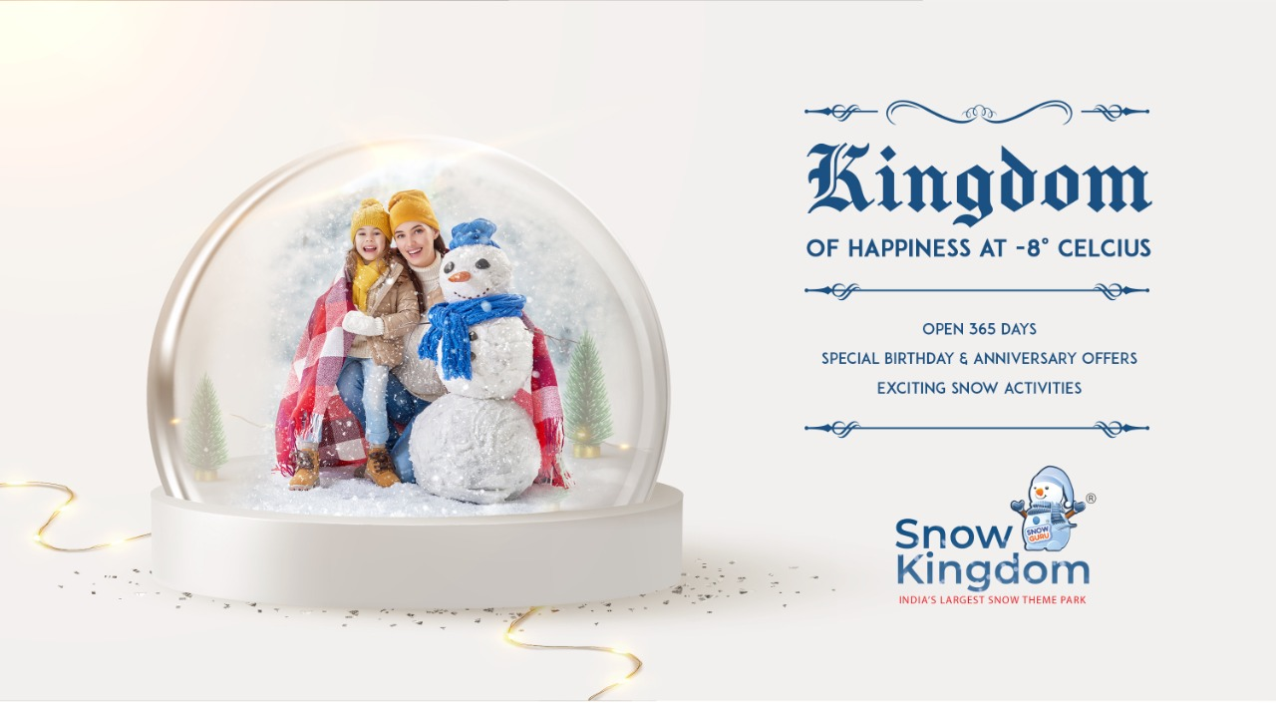

Slide 77
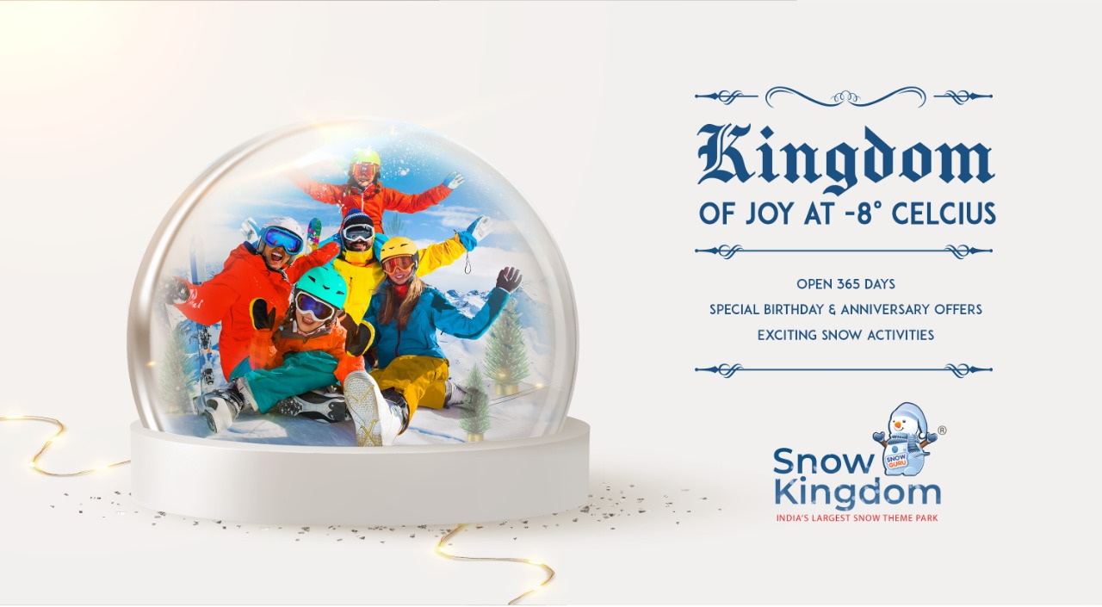

Slide 78
Snow Kingdom
(Snow Theme Park)
Hyderabad Launch Campaign

Slide 79


Slide 80


Slide 81


Slide 82
KUMAR CORP
(Real Estate)
Corporate Campaign

Slide 83


Slide 84


Slide 85


Slide 86
Continental Futura
Child Centric – 1 & 2 BHK Homes

Slide 87


Slide 88


Slide 89


Slide 90
Continental Futura
1 & 2 BHK Homes

Slide 91
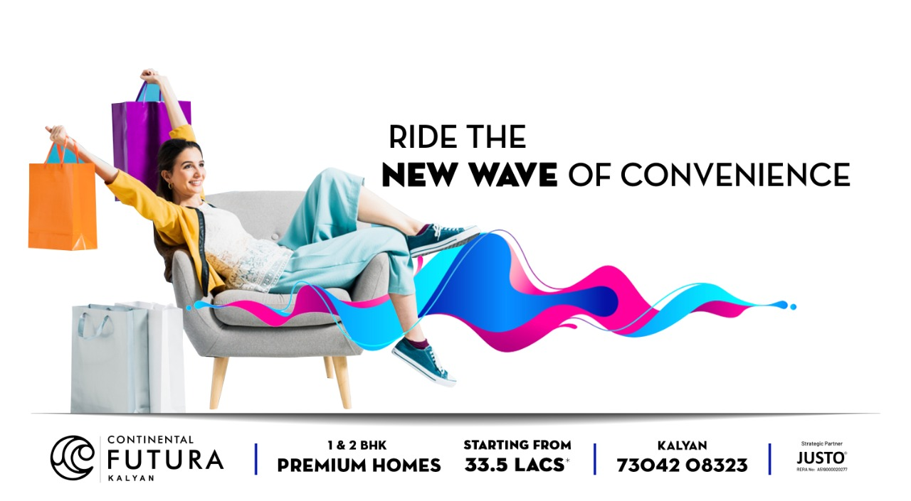

Slide 92


Slide 93


Slide 94
YOO ONE
(Ultra Premium Homes)
Concept 1

Slide 95


Slide 96


Slide 97


Slide 98
YOO ONE
(Ultra Premium Homes)
Concept 2

Slide 99


Slide 100


Slide 101
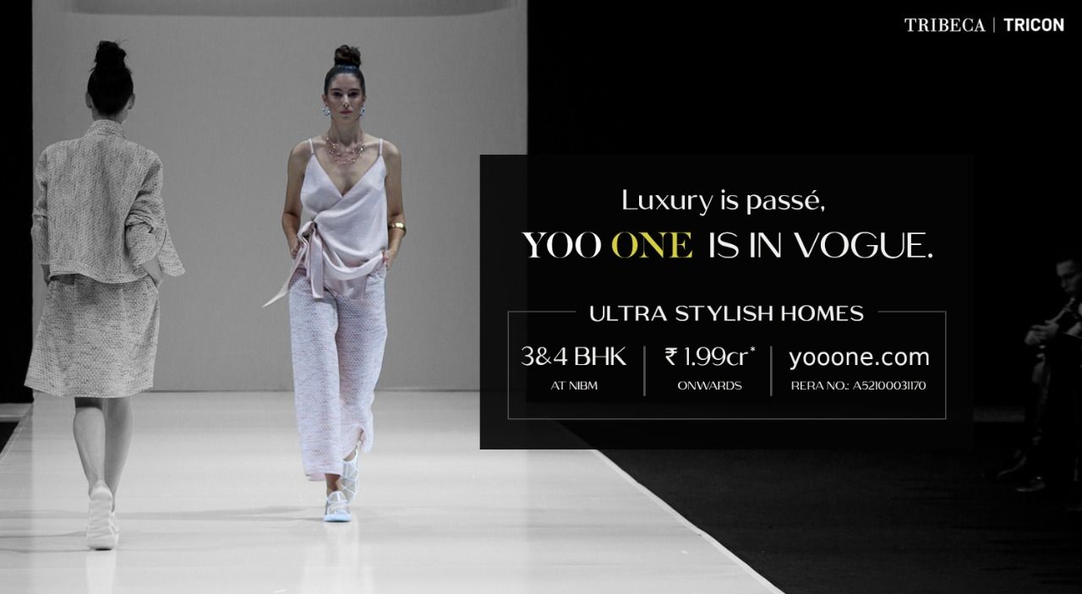

Slide 102
STIHL INDIA
(Genuine Parts Ad)

Slide 103


Slide 104
STIHL INDIA
(Lawn Mower Ad)

Slide 105
JBJ
(Jewellery Brand)

Slide 106
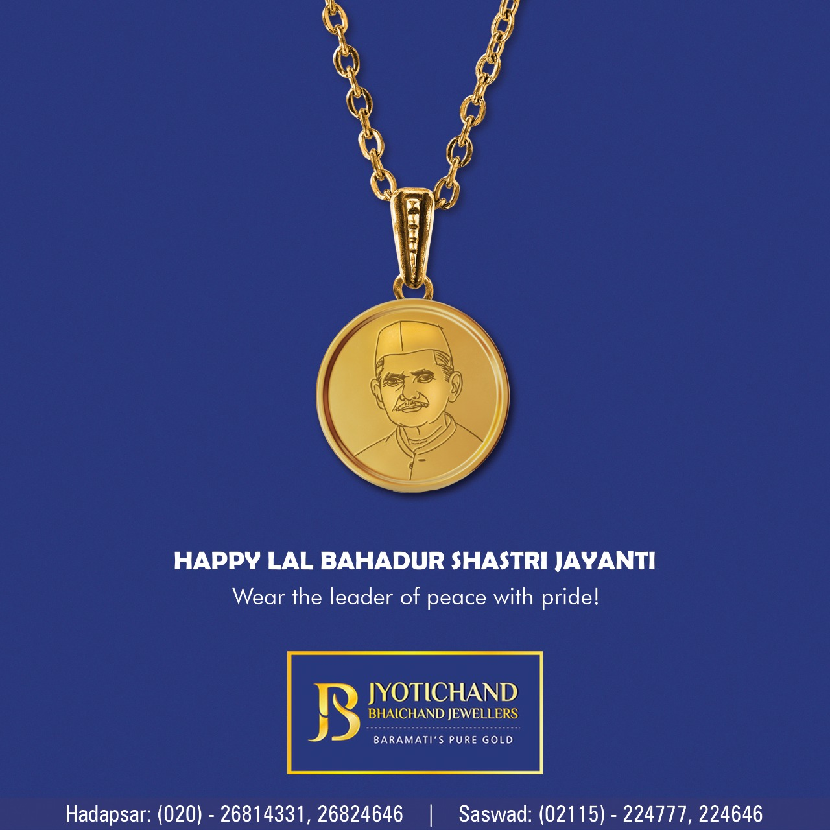

Slide 107


Slide 108
Vaibhavlaxmi Developers
(Real Estate Brand)

Slide 109
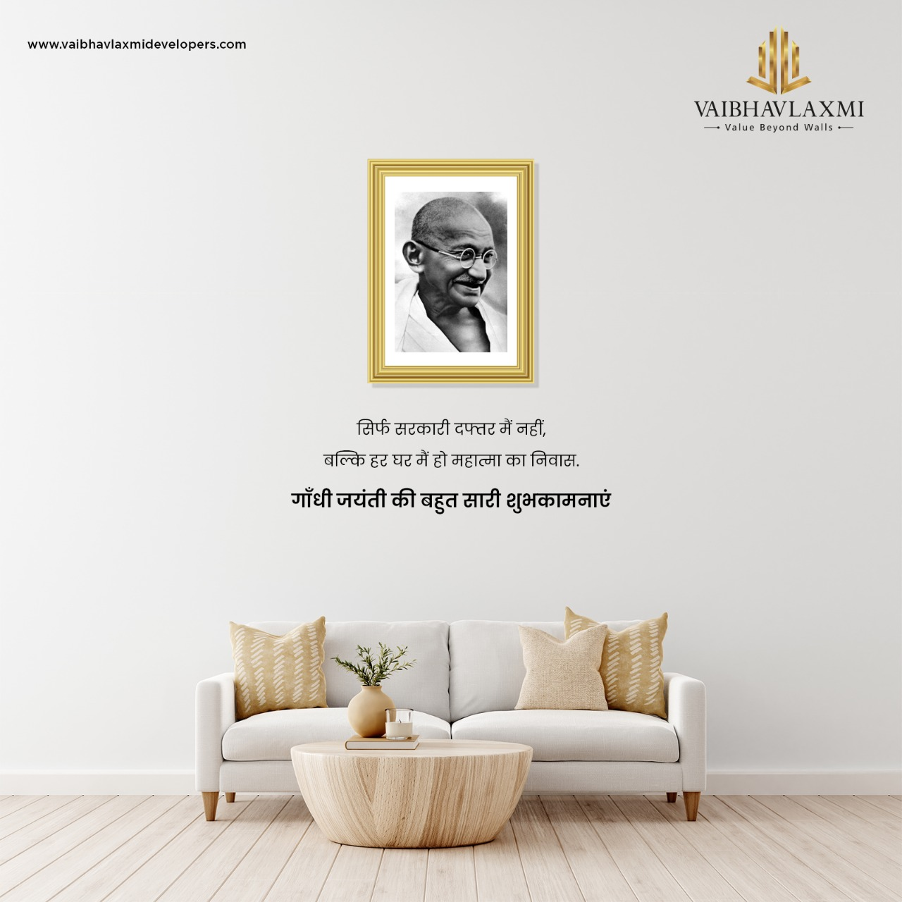

Slide 110
WAKAU
Short video sharing social media app

Slide 111
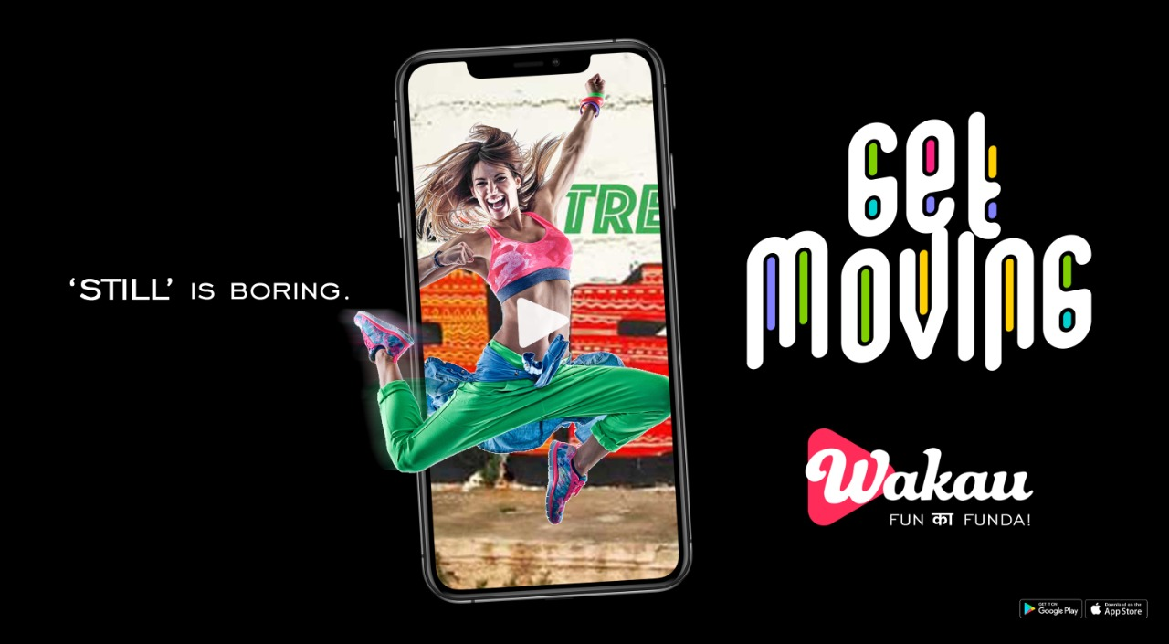

Slide 112
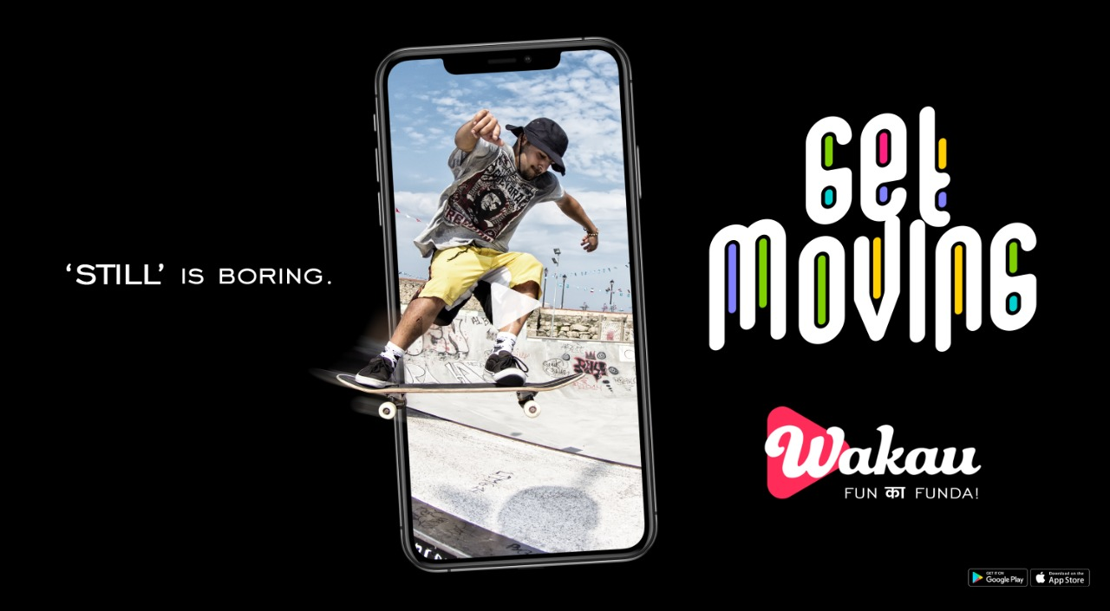

Slide 113
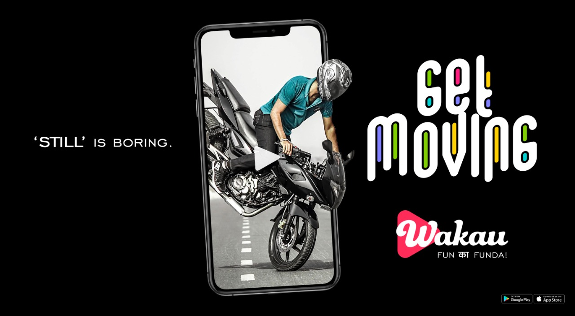

Slide 114
WAKAU
Short video sharing social media app

Slide 115
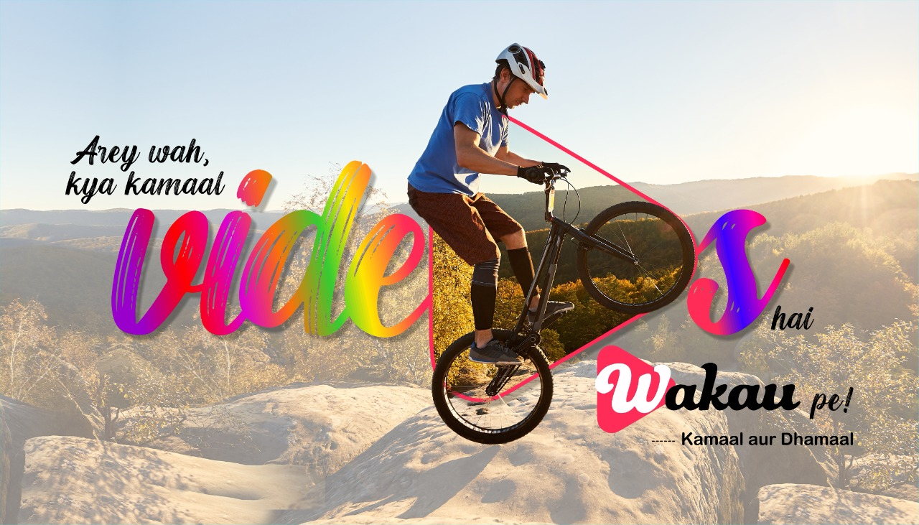

Slide 116


Slide 117
WAKAU
Short video sharing social media app
CONCEPT 3

Slide 118


Slide 119


Slide 120
PASHIMINA WATERFRONT
3 BHK apartments & 4 Bed penthouses

Slide 121
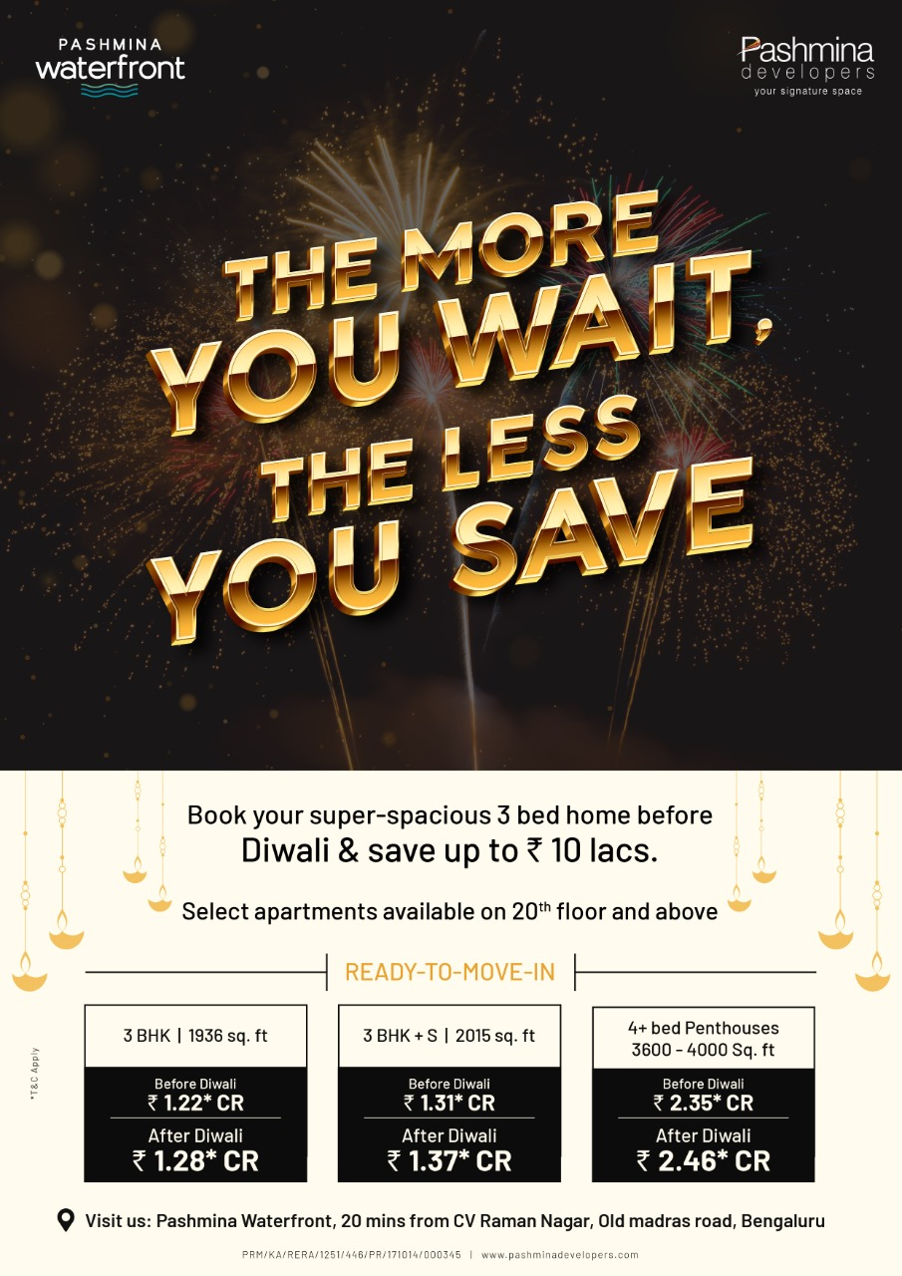

Slide 122
STIHL
Agriculture & cleaning equipment

Slide 123


Slide 124
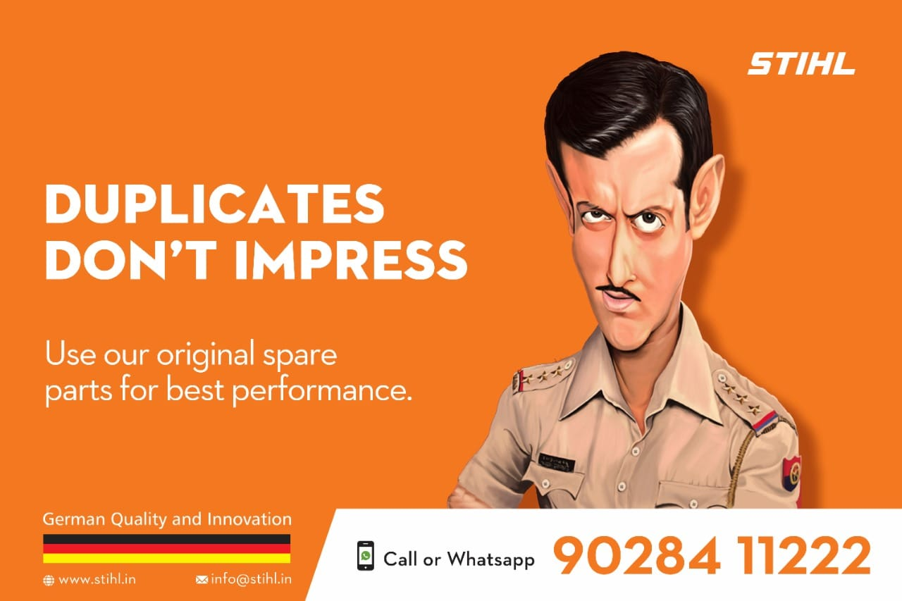

Slide 125
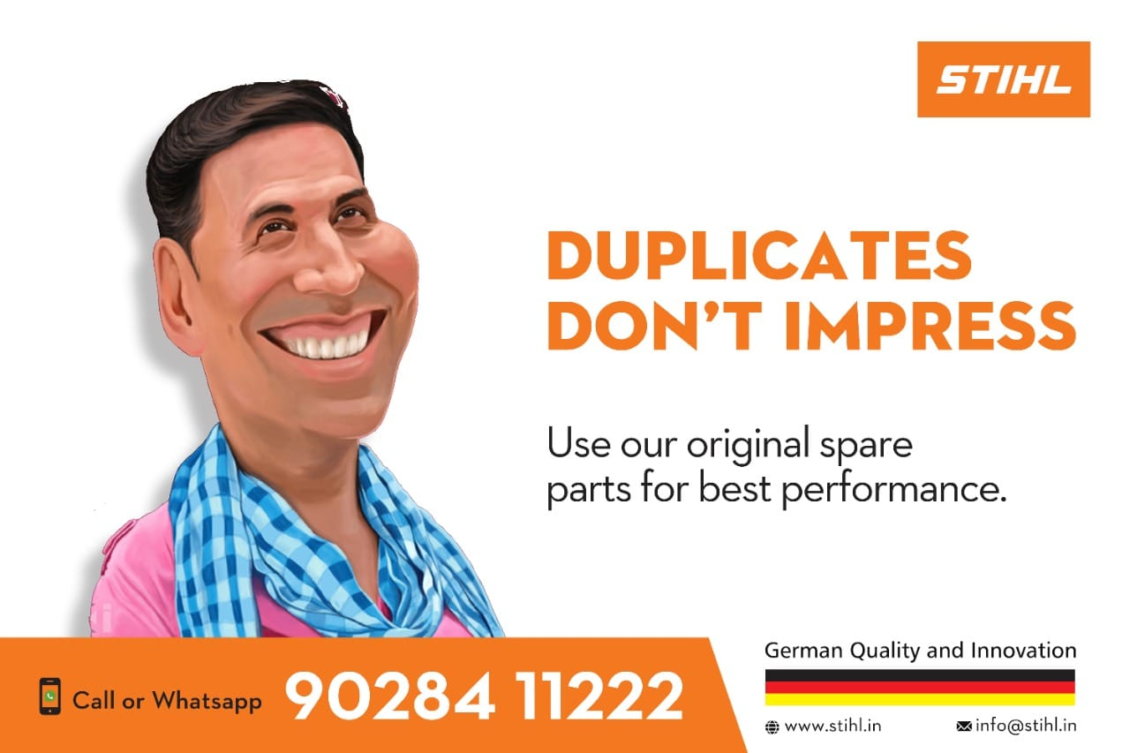

Slide 126
VAIBHAVLAMI JEWELLERS

Slide 127


Slide 128


Slide 129


Slide 130


Slide 131
WAKAU
Social Media Short Video Sharing App
(Campaign 1)

Slide 135
WAKAU
Social Media Short Video Sharing App
(Campaign 1)

Slide 136


Slide 137


Slide 138
Real Estate
Panvelkar Greens
1 and 2 BHK Homes

Slide 139
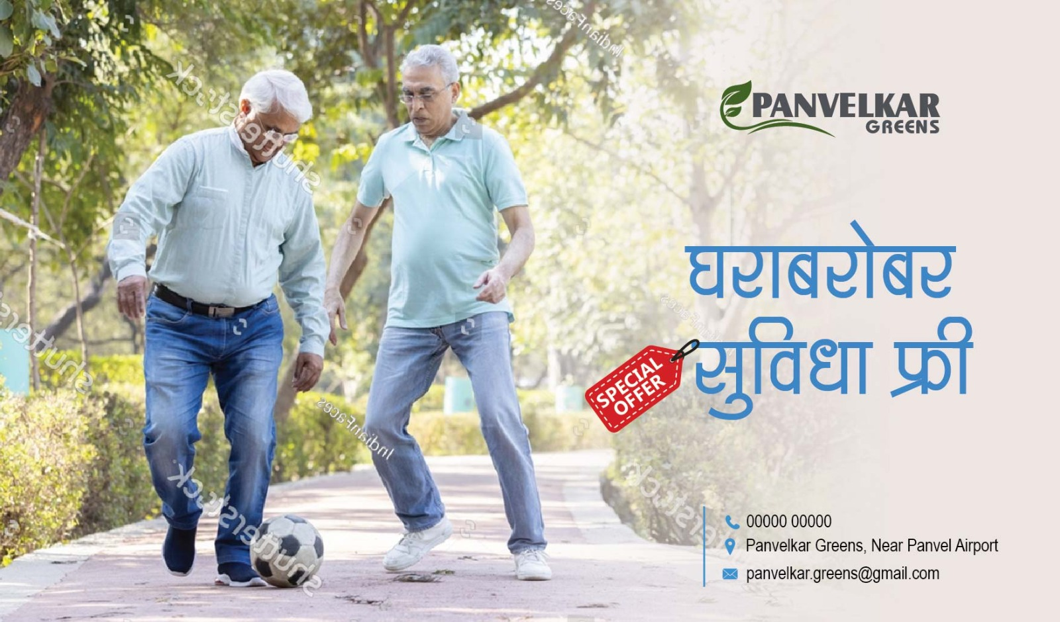

Slide 140


Slide 141
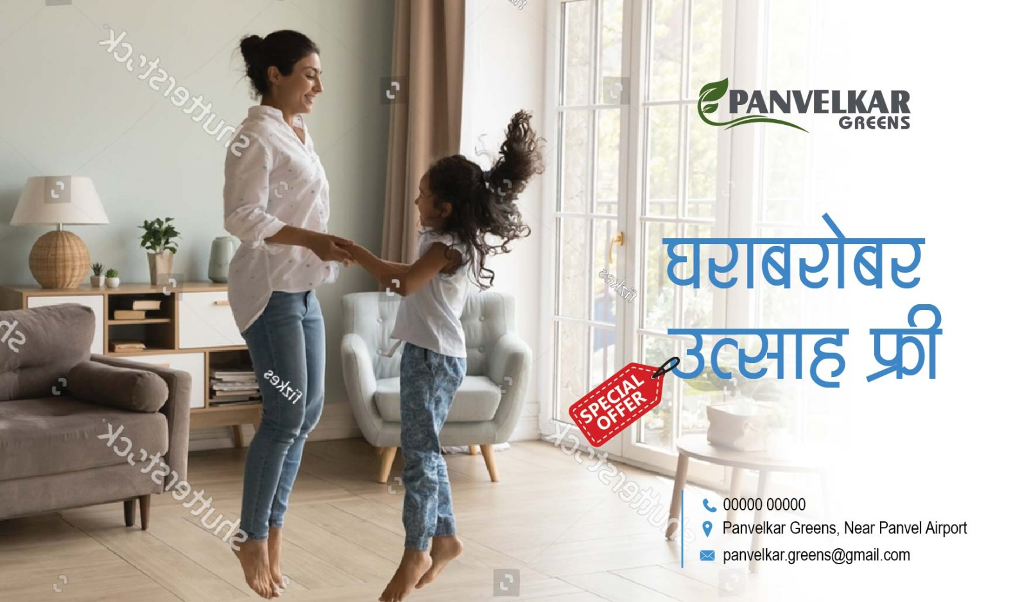

Slide 142
ARATT GROUP
Real Estate
Corporate Campaign

Slide 143
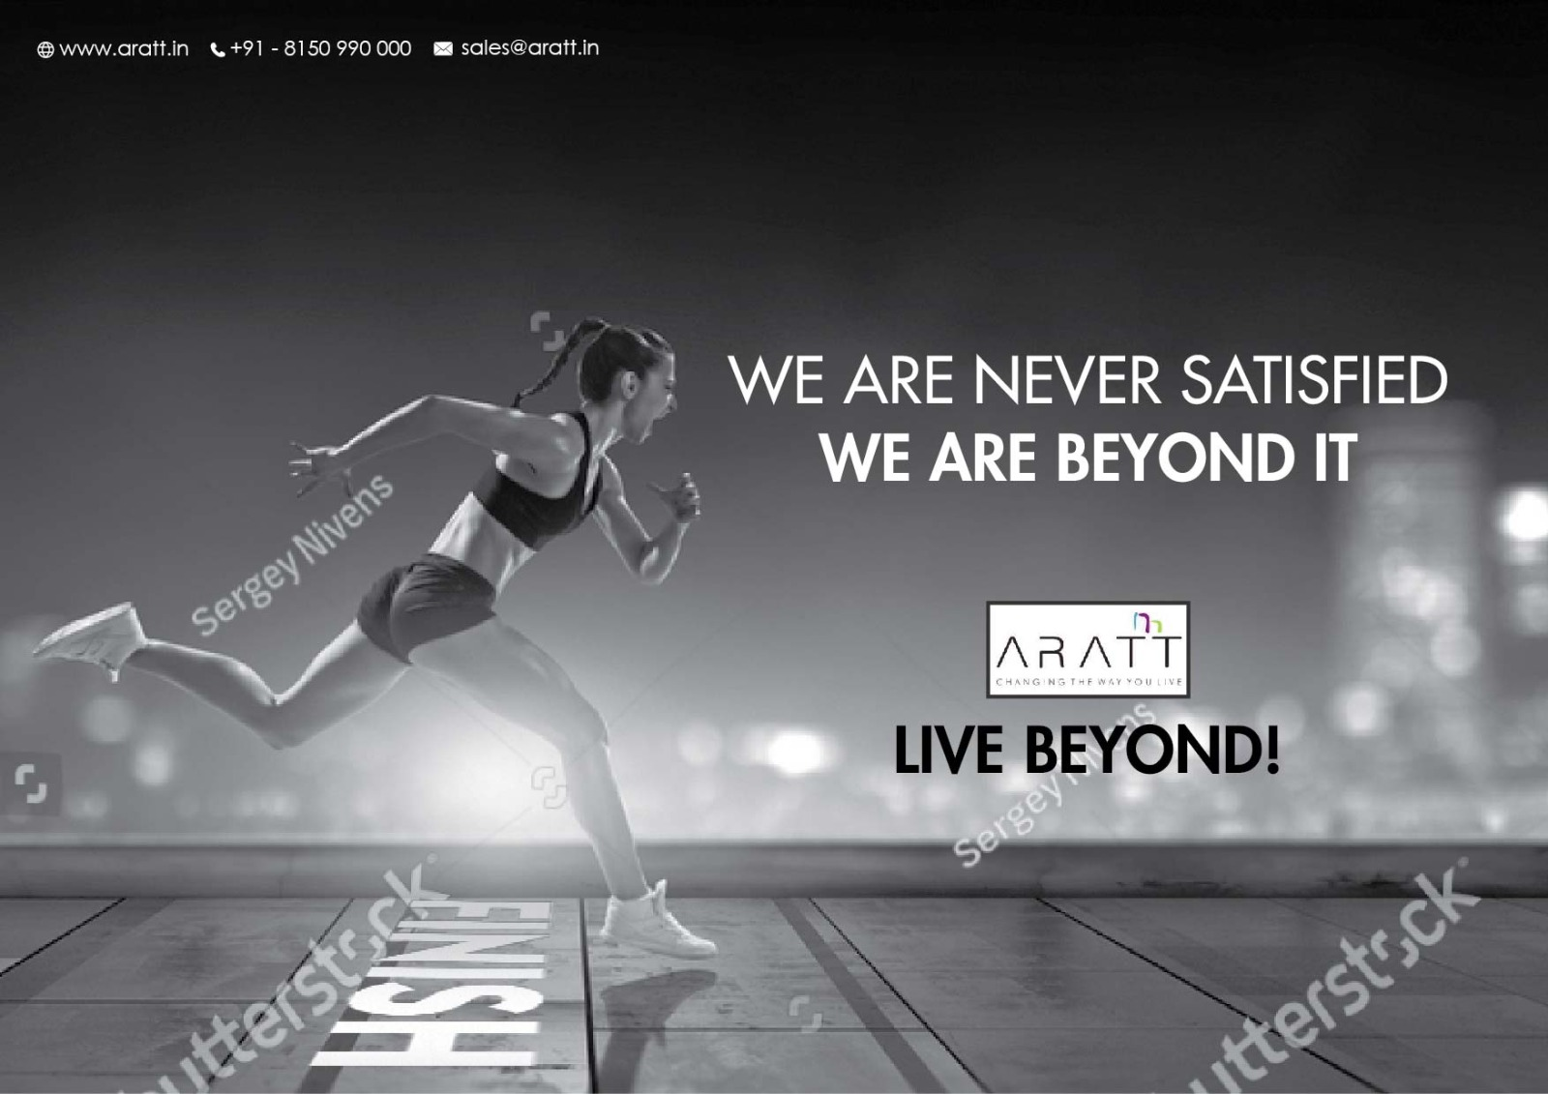

Slide 144
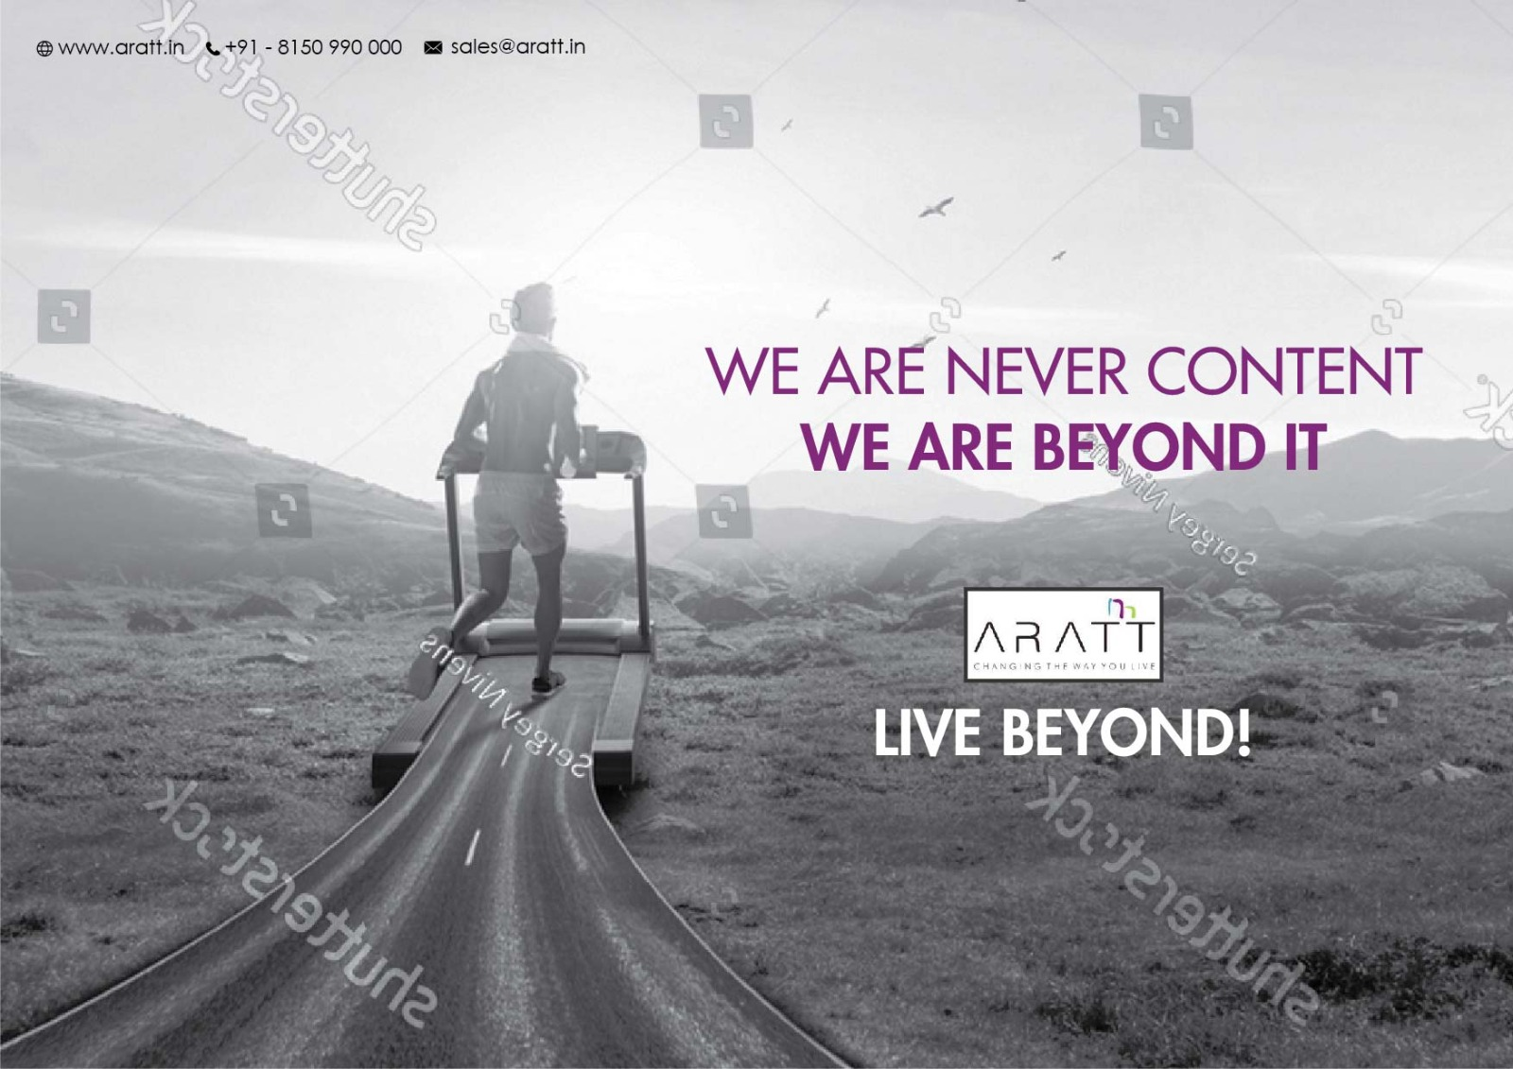

Slide 145


Slide 146
Westend Mall
Jeans and Sneakers Fest

Slide 147


Slide 148


Slide 149
Real Estate
Project – Panvelkar Greens

Slide 150


Slide 151


Slide 152


Slide 153
Father’s Day ads for Jewellers

Slide 154


Slide 155


Slide 156


Slide 157


